Slide 1

Agile MBOs

Slide 2
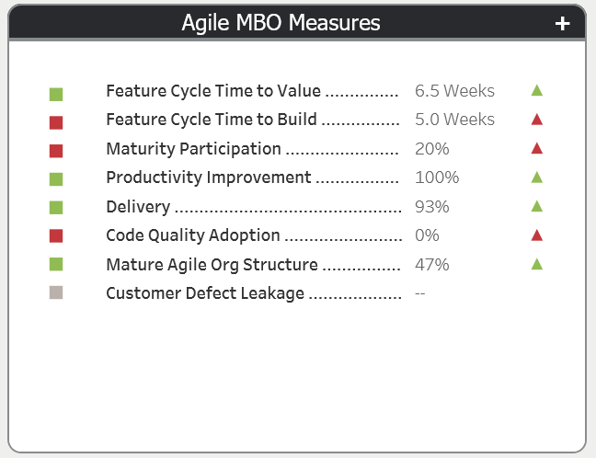
OSAM Reporting Hub - OptumRx
URL: https://opear.uhc.com/ReportingHub/home

Slide 3
Feature Cycle Time Overview
Feature Cycle Time (applies at product level)
What is changing?
Take advantage of new data linkages to allow reporting by product as well as org structure
Improve visibility to pended feature volume (features built but not released to market)
Time to Build
Measure: Annual improvement in mean time between feature development start and ready for release
Target: 15% YoY Time to Build (TTB) improvement
Time to Value
Measure: Annual improvement in mean time between feature development start and release to market
Target: 15% YoY Time to Build (TTV) improvement
Scope
Optum Technology
Purpose
Drives agile maturity by encouraging delivery teams to focus on delivering features to production in as short a time possible.
Notes:
Recommendations:
- Choose Continuous Improvement as Productivity MBO; keep Annual Improvement as a measure
Choose In-Year Improvement based on sustainability concerns, allow SUS Survey and SUS Audit
Benefits:
- Simplified setup and management (no baselining, stop 50% of DCR requests)

Slide 4
OSAM Maturity Participation Overview
OSAM Maturity (applies at team level)
What is changing?
New quarterly measure focusing on team attestations of four OSAM practices:
OSAM Adoption – Yes/No attestation with repository URL asserting timely completion of OSAM required artifacts
90 Day Assessment Completed – Demonstrated by presence of OSAM Maturity Assessment
Action Plan Completed – Demonstrated by presence of an Action Plan within CA Agile Central
CI Adoption -- Yes/No attestation with repository URL asserting timely completion of OSAM required artifacts
OSAM Capability Assessment Participation (new)
Measure: Implementation and successful execution of the four practices
Each team is assessed on all four components, with each component counting 25% towards team score.
Portfolio roll ups are aggregations of their teams’ quarterly assessment scores.
Target: Portfolios must achieve 50% in Q1, 60% in Q2, 70% in Q3, and 75% in Q4.
Notes:
Recommendations:
- Choose Continuous Improvement as Productivity MBO; keep Annual Improvement as a measure
Choose In-Year Improvement based on sustainability concerns, allow SUS Survey and SUS Audit
Benefits:
- Simplified setup and management (no baselining, stop 50% of DCR requests)

Slide 5
Productivity
Productivity(applies at product level)
What is changing?
Disconnect from PI time boxes to increase sample frequency and support all OSAM planning horizons
Rewire data intake to integrate product work and hours (vs. capital focused measure)
Minimize or eliminate baseline management, streamlining process and enabling teams to enroll any time
Productivity Continuous Improvement (new)
Measure: Ratio of quarterly productivity against previous quarter; 2.5% improvement per quarter
Target: Maximize number of quarters demonstrating 2.5%+ improvement (2 => Meets, 4 => Exceeds)
Productivity Annual Improvement (updated) (measure only)
Measure: Ratio of current annual productivity against previous year; 10% improvement per year
Target: Demonstrate 10% gains in overall productivity year over year

Slide 6
Mature Agile Organization Structure
Mature Agile Org Structure(new)
Improvement Goal/Target
To Be Determined
Mature Agile Org Structure Calculation
(Dedicated Resources Percentage + Co-Located Resources Percentage) / 2
Dedicated Resources Percentage = Number of Dedicated Scrum or Agile “TEAM Members” / Number of Scrum or Agile “TEAM Members”
Co-Located Resources Percentage = Number of “Scrum or Agile TEAM Members” in same City / Number of “Scrum or Agile TEAM Members”.
Business Rules
Scrum or Agile team Member = TEAM Member with the Team Member Role of Scrum Master, Product Owner, or Development Team ( Development Team role can be assigned to any Developer including QA Developer)
Dedicated for a Scrum Master Role = 1-3 teams (if a Scrum Master is on 4 or more teams they are not considered dedicated)
Dedicated for Product Owner Role = 1-3 teams (if a Product Owner is on 4 or more teams they are not considered dedicated)
Dedicated for Development Team Role = 1 team ( if a Development Team Member is on 2 or more teams they are not considered dedicated)

Slide 7
Delivery - Scope
Scope
What is changing?
The Scope delivery measure remains unchanged but will now be collected automatically from CA Agile rather than gathered through Tracker entries. Sprinting and Flow projects will be exempted from this measure.
Scope Delivery (updated)
Assessed by comparing the number of “Must” features completed at the end of the planning increment compared to the number planned at the beginning of the planning increment. Will also include features that do not have a MoScoW priority setting.
Planned = # of Must Features attached to Release object at PI Start + 7 days
Delivered = # of Must Features attached to Release object completed by Release object end date
Target: Number of delivered Must features must equal or exceed 90% of planned features.
Enabling this Measure
Feature Guidance
Features must be identified by MoSCoW priority scale. “Must” prioritized features make up the majority of planned content for a planning increment. If MoSCoW I used, only those features are counted as planned scope for this delivery measure.
Release Guidance
Features must be attached to the Program Increment (Release Object) within calendar 7 days of the release object start date to be counted as planned scope.

Slide 8
Delivery - Schedule
Schedule
What is changing?
The Schedule delivery measure remains unchanged but will now be collected automatically from CA Agile rather than gathered through Tracker entries. Sprinting and Flow projects will be exempted from this measure.
Schedule Delivery (updated)
Assessed by comparing the actual release end date to the committed release end date. If the actual date exceeds 10% beyond your original committed date, you fail.
Target: PI completion will be within a variance of 10% of PI duration from the planned end date in the CA Agile Release object.
Enabling this Measure
Release Guidance
The start and end dates in the Release time box object must be populated before execution on a planning increment starts and be maintained to reflect and time box beginning and end date changes made.
Time box end dates do not need to correlate to software releases (delivery of code for production use) – a timebox can contain one, many, or no releases to production.

Slide 9
Delivery - Quality
Quality
What is changing?
To allow for increasing release frequencies associated with Agile and Continuous Delivery, the old measure of “Sev 1 defects open at time box completion will be replaced with a cycle time measure focused on how quickly critical and major production defects are resolved.
Quality Delivery (updated)
Measure: Time from submission to closure will be calculated for all internal defects closed within the time box. Defects exceeding 28.0 days to closure are considered failing while defects less than or equal to 28.0 days to closure are considered passing.
Target: 100% of all critical and major defects are closed less than or equal to 28.0 days.
Enabling this Measure*
Defect Guidance
Quality Delivery is intended to be focused on internal defects. This includes Alpha, Beta, UAT, and other pre-production defects reported due to proactive quality work should be flagged as Beta/UAT Reported and not flagged as Customer Reported and will be included in the Delivery MBO

Slide 10
Code Quality Overview
Code Quality
What is changing?
New measure to drive code quality adoption
For Code Quality Adopted Teams (updated)
Measure: Team improvement towards individualized code quality gate targets
Target: Achievement of selected quality goal and/or implementation of automated release pipeline enforcement of code quality controls
Meeting target gate = Meets, beating gate by 2 = Exceeds
Implementing automated release pipeline enforcement = Exceeds (regardless of gate progress)
For Code Quality Adopting Teams
Measure: Adoption of code quality analysis (SonarQube)
Target: 95% Org-level adoption targets for groups with no/limited Sonar implementation
<90% = NI-1 | 90%-<95% = NI-2 | 95%-<97% = ME-3 | 97%-<100 = ME-4 | 100% = EE-5
Notes:
What is the CI Integration indicator?
How do we know the groups that have sonar limitations?
What is the target list??? It does not match what was built.

Slide 11
Customer Defect Leakage Overview
Customer Defect Leakage (applies at product level)
What is changing?
Take advantage of new data linkages to allow reporting by product as well as org structure
Measure and calculations (unchanged)
Measure: Annual improvement in defect leakage trend, displayed as YoY monthly cumulative performance
Target: 10% improvement versus prior year
Scope
Optum Technology
Workspaces currently Included
Optum
Tech Engineering
TFS Enterprise
Purpose
Drive quality focus by reducing leaked defects.
This will allow us to bring the customer closer by helping to improve our NPS score and will result in increased customer loyalty.

Slide 12
Let us understand the “Why”
MBO
Why?
Measure
Productivity
Feature Cycle Time
Respond to market faster
Time to market
Annual improvement
Features pending delivery
Customer Defect Leakage & User Experience
Bring the customer closer
Higher NPS
Improve employee engagement
Improve customer loyalty
Planned vs unplanned releases
NPS score
OSAM Maturity
Empowers teams
Increase productivity
Agile metrics
Code Quality
Time to market
Continuous quality
Sonar rules
Optum Tech Delivery
Improve customer loyalty
Predictability
Agile metrics
Mature Agile Organization Structure
Team Stickiness
Team Collaboration
Dedicated Teams
Empowered Teams

Slide 13
Feature Cycle Time Overview
Feature Cycle Time (applies at product level)
What is changing?
Take advantage of new data linkages to allow reporting by product as well as org structure
Improve visibility to pended feature volume (features built but not released to market)
Time to Build
Measure: Annual improvement in mean time between feature development start and ready for release
Target: 15% YoY Time to Build (TTB) improvement
Time to Value
Measure: Annual improvement in mean time between feature development start and release to market
Target: 15% YoY Time to Build (TTV) improvement
Scope
Optum Technology
Purpose
Drives agile maturity by encouraging delivery teams to focus on delivering features to production in as short a time possible.
Notes:
Recommendations:
- Choose Continuous Improvement as Productivity MBO; keep Annual Improvement as a measure
Choose In-Year Improvement based on sustainability concerns, allow SUS Survey and SUS Audit
Benefits:
- Simplified setup and management (no baselining, stop 50% of DCR requests)

Slide 14
Feature Cycle Time Calculation Detail
Group By Cost Center Structure
Product, Asset or Billing Application (future enhancement)
Target/Goal 15% cycle time improvement
Time To Build | Baseline | Average Feature Cycle Time calculated in weeks for all features meeting criteria: ACTUAL START DATE is greater than or equal to 1/1/2017 and ACTUAL END DATE is less than 12/31/2017 and FEATURE DELIVERY TYPE is not “Non-Deliverable” or “ Deliverable-O&M”
 | Current Year | Average Feature Cycle Time calculated in weeks for all features meeting criteria: ACTUAL START DATE is greater than or equal to 1/1/2018 and ACTUAL END DATE is less than 12/31/2018 and FEATURE DELIVERY TYPE is not “Non-Deliverable” or “ Deliverable-O&M”
 | Target | (Baseline*.85)=2018 Goal
Time to Value | Baseline | Average Feature Cycle Time calculated in weeks for all features meeting criteria: ACTUAL START DATE is greater than or equal to 1/1/2017 and PRODUCTION DATE is less than 12/31/2017* FEATURE DELIVERY TYPE is not “Non-Deliverable” or “ Deliverable-O&M”
 | Current Year | Average Feature Cycle Time calculated in weeks for all features meeting criteria: ACTUAL START DATE is greater than or equal to 1/1/2017 and ACTUAL END DATE is less than 12/31/2018 FEATURE DELIVERY TYPE is not “Non-Deliverable” or “ Deliverable-O&M”
 | Target | (Baseline*.85)=2018 Goal
*Additional logic is used if there is a TTB value with no TTV in 2017.
Notes:
Recommendations:
- Choose Continuous Improvement as Productivity MBO; keep Annual Improvement as a measure
Choose In-Year Improvement based on sustainability concerns, allow SUS Survey and SUS Audit
Benefits:
- Simplified setup and management (no baselining, stop 50% of DCR requests)

Slide 15
Feature Cycle Time Data Element Detail
Group By
Cost Center Structure
Product, Asset or Billing Application (future enhancement)
Target/Goal
15% cycle time improvement
Measure | Source System | Data Element | Attribute | Sub Attribute | Commonly Responsible
Time to Build Time to Value | CA Agile | Feature | Feature Type | Deliverable-O&M Non Deliverable | PO/Scrum Master/RTE
Time to Build Time to Value | CA Agile | Feature | Start Date | N/A | Derived from associated user story moving to PHASE “In Progress”
Time to Build | CA Agile | Feature | End Date | N/A | Derived from all associated user stories being in PHASE “Accepted”
Time to Build Time to Value | CA Agile | User Story | Status | In Progress Accepted | Scrum Master/Delivery Team/PO
Time to Value | CA Agile | Feature | Production Date | N/A | RTE/PO
Notes:
Recommendations:
- Choose Continuous Improvement as Productivity MBO; keep Annual Improvement as a measure
Choose In-Year Improvement based on sustainability concerns, allow SUS Survey and SUS Audit
Benefits:
- Simplified setup and management (no baselining, stop 50% of DCR requests)

Slide 16
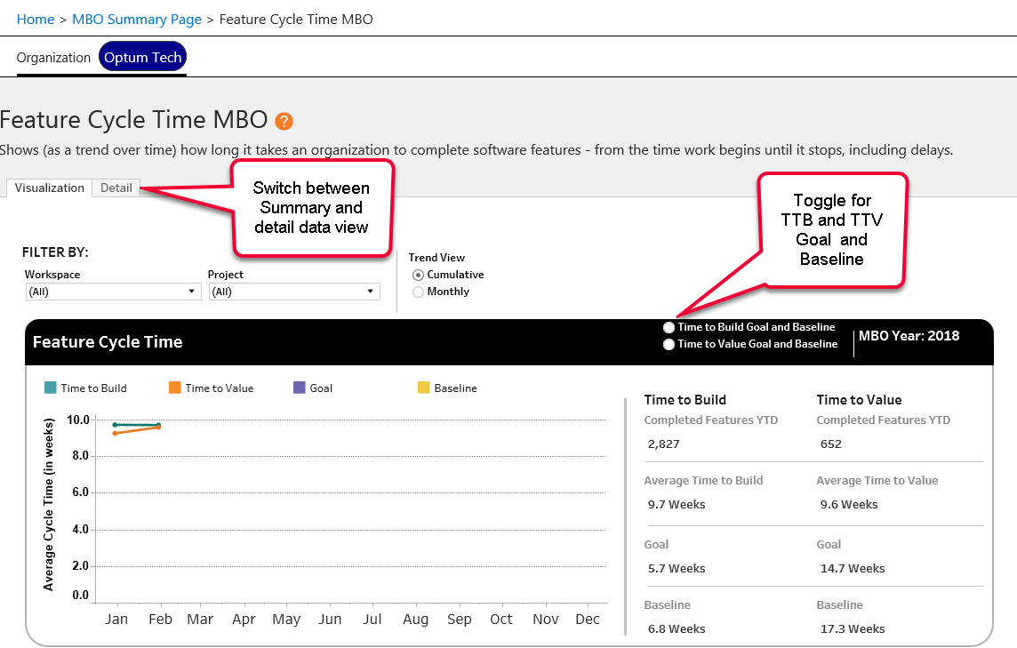
Summary Report – Feature Cycle Time MBO
Notes:
MVP – Org. filtering:
Default project assignment – majority of team is assigned to GL Dept.
Future:
Advance filter option – any of team is assigned to GL Dept.
Project may show in more than one filter option but never duplicated – (assignment goes to majority logic when rolled up.)
Projects can be set at inactive by GL Owner
Inactive applies to the organization hierarchy – unless another GL Owner activates (at which time the organization intersect will show the project)

Slide 17
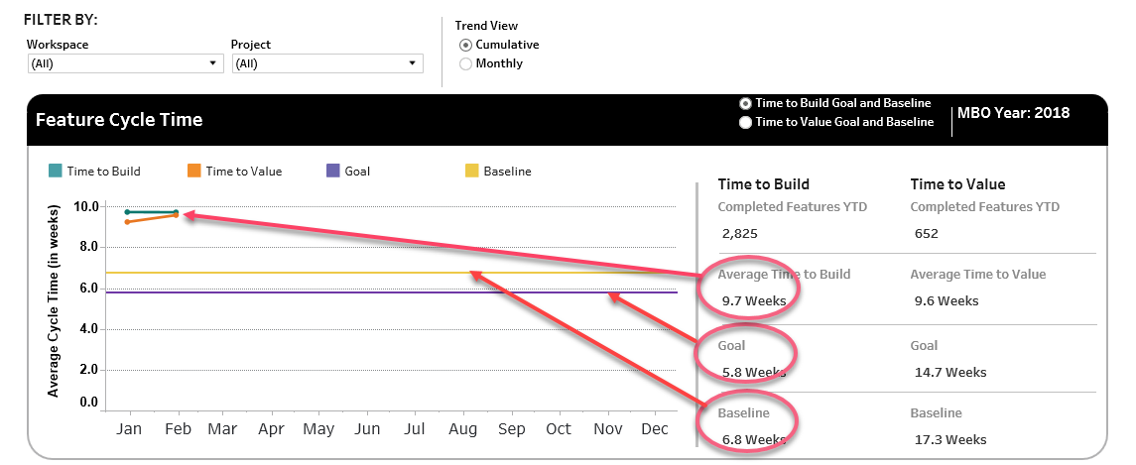
Summary Report – Feature Cycle Time MBO
Notes:
MVP – Org. filtering:
Default project assignment – majority of team is assigned to GL Dept.
Future:
Advance filter option – any of team is assigned to GL Dept.
Project may show in more than one filter option but never duplicated – (assignment goes to majority logic when rolled up.)
Projects can be set at inactive by GL Owner
Inactive applies to the organization hierarchy – unless another GL Owner activates (at which time the organization intersect will show the project)

Slide 18
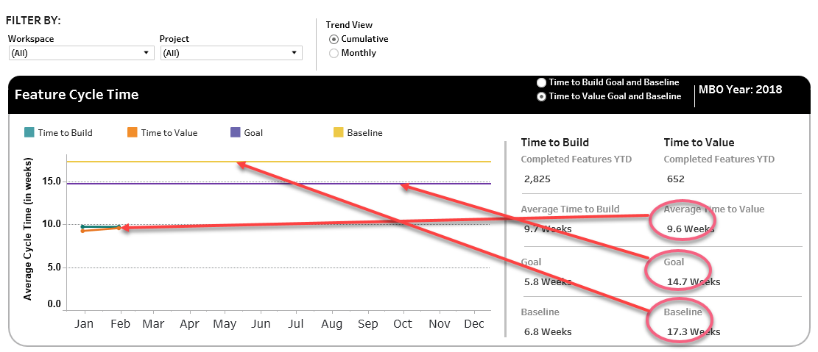
Summary Report – Feature Cycle Time MBO
Notes:
MVP – Org. filtering:
Default project assignment – majority of team is assigned to GL Dept.
Future:
Advance filter option – any of team is assigned to GL Dept.
Project may show in more than one filter option but never duplicated – (assignment goes to majority logic when rolled up.)
Projects can be set at inactive by GL Owner
Inactive applies to the organization hierarchy – unless another GL Owner activates (at which time the organization intersect will show the project)

Slide 19
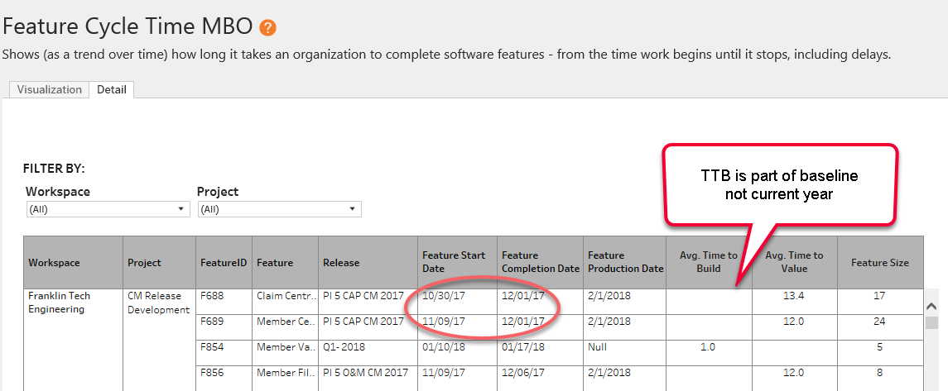
Detail Report – Feature Cycle Time MBO
Notes:
MVP – Org. filtering:
Default project assignment – majority of team is assigned to GL Dept.
Future:
Advance filter option – any of team is assigned to GL Dept.
Project may show in more than one filter option but never duplicated – (assignment goes to majority logic when rolled up.)
Projects can be set at inactive by GL Owner
Inactive applies to the organization hierarchy – unless another GL Owner activates (at which time the organization intersect will show the project)

Slide 20
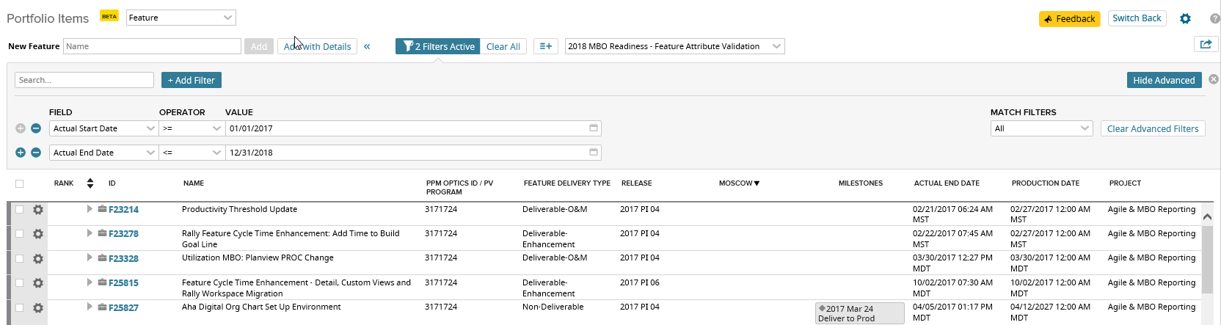
Feature Cycle Time – Troubleshooting Tips
Use views in CA Agile to monitor Features have all data elements used in the measure populated
Adjust Actual Start and End Date operators to review baseline vs current year data
Notes:
MVP – Org. filtering:
Default project assignment – majority of team is assigned to GL Dept.
Future:
Advance filter option – any of team is assigned to GL Dept.
Project may show in more than one filter option but never duplicated – (assignment goes to majority logic when rolled up.)
Projects can be set at inactive by GL Owner
Inactive applies to the organization hierarchy – unless another GL Owner activates (at which time the organization intersect will show the project)

Slide 21
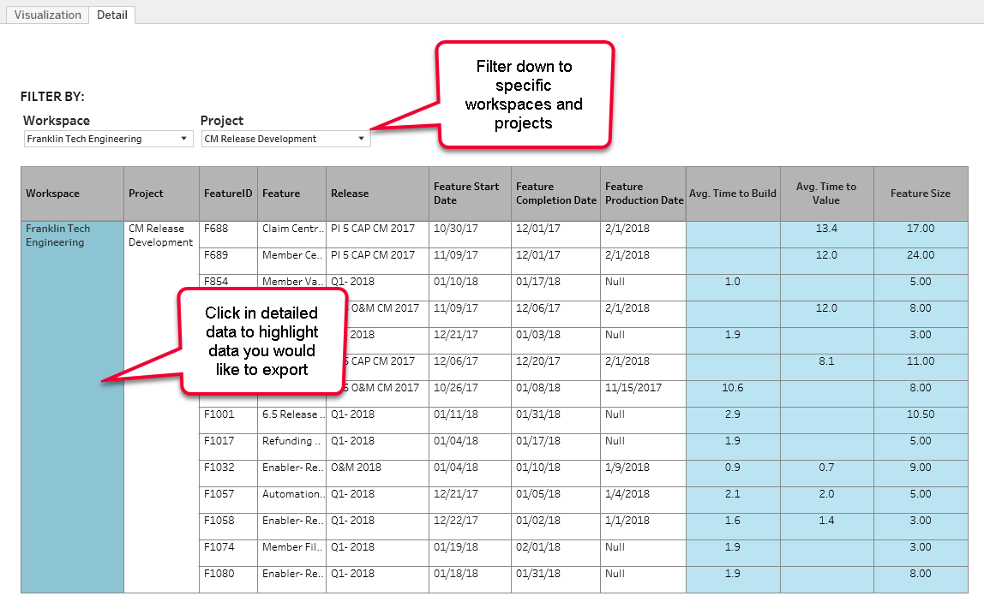
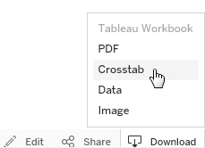
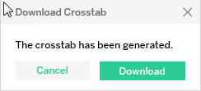
Summary Report – Troubleshooting Tips
Notes:
MVP – Org. filtering:
Default project assignment – majority of team is assigned to GL Dept.
Future:
Advance filter option – any of team is assigned to GL Dept.
Project may show in more than one filter option but never duplicated – (assignment goes to majority logic when rolled up.)
Projects can be set at inactive by GL Owner
Inactive applies to the organization hierarchy – unless another GL Owner activates (at which time the organization intersect will show the project)

Slide 22
Appendix
Feature Delivery Type
Feature Program Code
Feature Production Date
Notes:
Recommendations:
- Choose Continuous Improvement as Productivity MBO; keep Annual Improvement as a measure
Choose In-Year Improvement based on sustainability concerns, allow SUS Survey and SUS Audit
Benefits:
- Simplified setup and management (no baselining, stop 50% of DCR requests)

Slide 23
OSAM Maturity Participation Overview
OSAM Maturity (applies at team level)
What is changing?
New quarterly measure focusing on team attestations of four OSAM practices:
OSAM Adoption – Yes/No attestation with repository URL asserting timely completion of OSAM required artifacts
90 Day Assessment Completed – Demonstrated by presence of OSAM Maturity Assessment
Action Plan Completed – Demonstrated by presence of an Action Plan within CA Agile Central
CI Adoption -- Yes/No attestation with repository URL asserting timely completion of OSAM required artifacts
OSAM Capability Assessment Participation (new)
Measure: Implementation and successful execution of the four practices
Each team is assessed on all four components, with each component counting 25% towards team score.
Portfolio roll ups are aggregations of their teams’ quarterly assessment scores.
Target: Portfolios must achieve 50% in Q1, 60% in Q2, 70% in Q3, and 75% in Q4.
Notes:
Recommendations:
- Choose Continuous Improvement as Productivity MBO; keep Annual Improvement as a measure
Choose In-Year Improvement based on sustainability concerns, allow SUS Survey and SUS Audit
Benefits:
- Simplified setup and management (no baselining, stop 50% of DCR requests)

Slide 24
OSAM Maturity Participation Calculation Detail
Group By Cost Center Structure
Target/Goal 65% participation
Capability Assessment | Is Capability Assessment survey result available for scrum team/child project? If Yes, Is Capability Assessment date within 90 days? If Yes, 25% Credit
Action Plan | Is Action Plan available for parent project or scrum team/child? If Yes, Is Action Plan date within 90 days? If Yes, 25% Credit
OSAM Adoption | Is OSAM Adoption box checked*? If Yes, Is OSAM Adoption date stamp within 90 days? If Yes, 25% Credit
CI Adoption | Is CI Adoption box checked? If Yes, Is CI Adoption date stamp within 90 days? If Yes, 25% Credit
Aggregation | All scores are averaged across organizational filter
*CA Adoption required URL to tool used to be populated.
Notes:
Recommendations:
- Choose Continuous Improvement as Productivity MBO; keep Annual Improvement as a measure
Choose In-Year Improvement based on sustainability concerns, allow SUS Survey and SUS Audit
Benefits:
- Simplified setup and management (no baselining, stop 50% of DCR requests)

Slide 25
OSAM Maturity Participation Data Element Detail
Group By
Cost Center Structure
Target/Goal
65% participation
Measure Component | Source System | Data Element | Attribute | Sub Attribute | Commonly Responsible
Capability Assessment | CA Agile (Integrated with Survey Gizmo) | OSAM Capability Assessment Report | Capability Assessment | Time box | Team
Action Plan | CA Agile | OSAM Capability Assessment Report | Parent/Child Project (Team) | Action Plan | Team
OSAM Adoption | CA Agile | OSAM Capability Assessment Report | OSAM Adoption | N/A | Team
CI Adoption | CI Adoption | OSAM Capability Assessment Report | CI Adoption | URL | Team
Notes:
Recommendations:
- Choose Continuous Improvement as Productivity MBO; keep Annual Improvement as a measure
Choose In-Year Improvement based on sustainability concerns, allow SUS Survey and SUS Audit
Benefits:
- Simplified setup and management (no baselining, stop 50% of DCR requests)

Slide 26
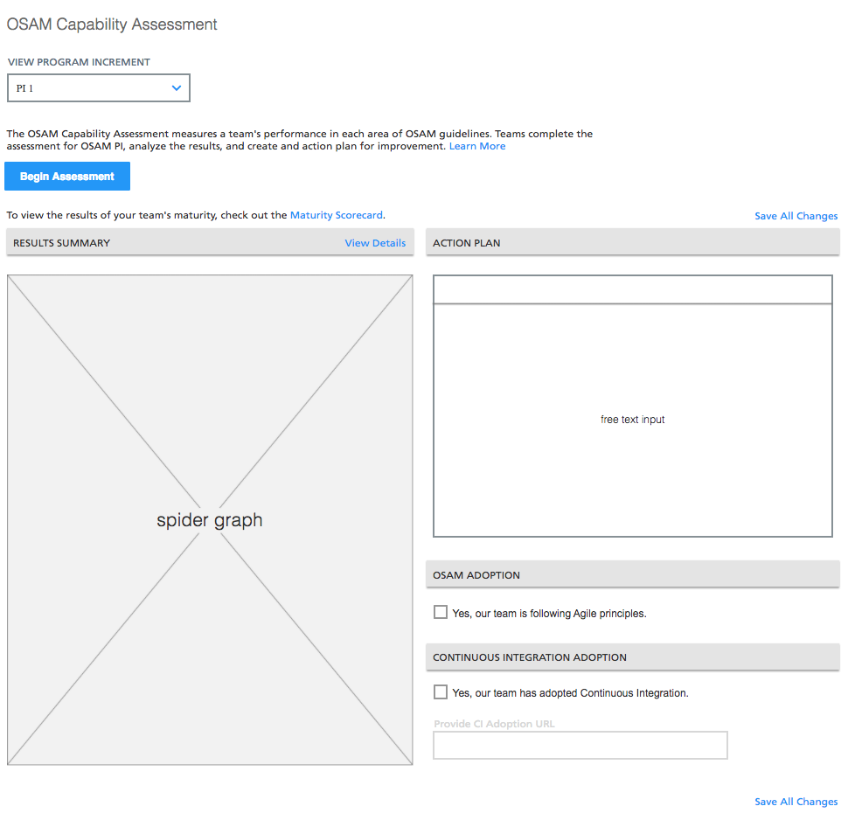

Capability Assessment
Capability Assessment is accessed from agile central
Notes:
MVP – Org. filtering:
Default project assignment – majority of team is assigned to GL Dept.
Future:
Advance filter option – any of team is assigned to GL Dept.
Project may show in more than one filter option but never duplicated – (assignment goes to majority logic when rolled up.)
Projects can be set at inactive by GL Owner
Inactive applies to the organization hierarchy – unless another GL Owner activates (at which time the organization intersect will show the project)

Slide 27
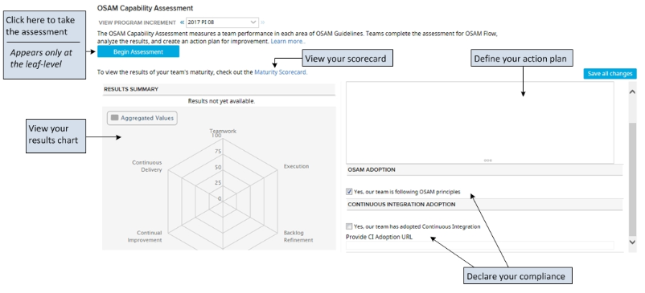
Capability Assessment
Planning Horizon Considerations
PI planning horizon teams can use their existing PI’s to align their assessments with
Sprinting and Flow planning horizon teams may need to create a OSAM Maturity Participation time box to align their assessment with
Each planning horizon has unique questions on the assessment
Notes:
MVP – Org. filtering:
Default project assignment – majority of team is assigned to GL Dept.
Future:
Advance filter option – any of team is assigned to GL Dept.
Project may show in more than one filter option but never duplicated – (assignment goes to majority logic when rolled up.)
Projects can be set at inactive by GL Owner
Inactive applies to the organization hierarchy – unless another GL Owner activates (at which time the organization intersect will show the project)

Slide 28
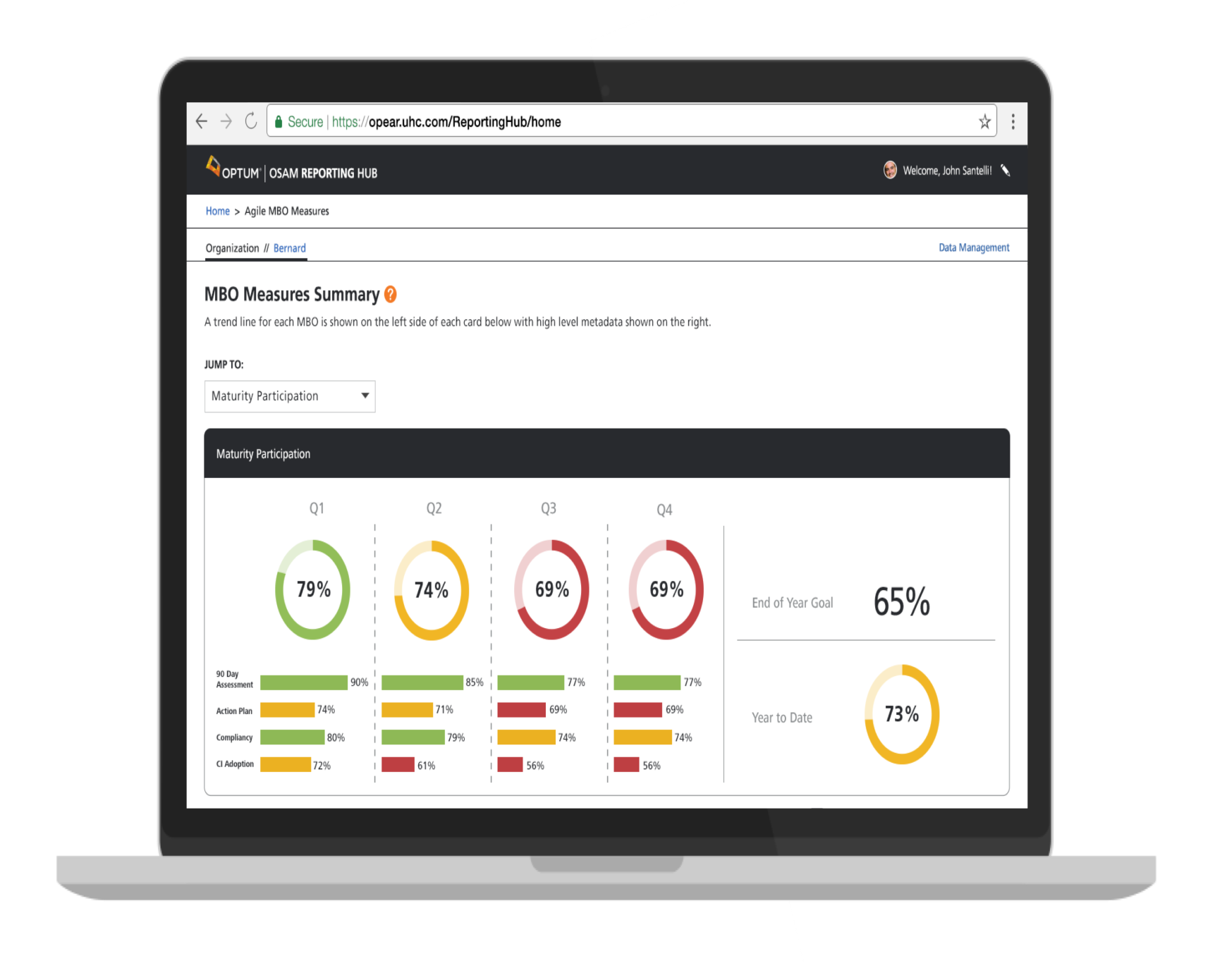
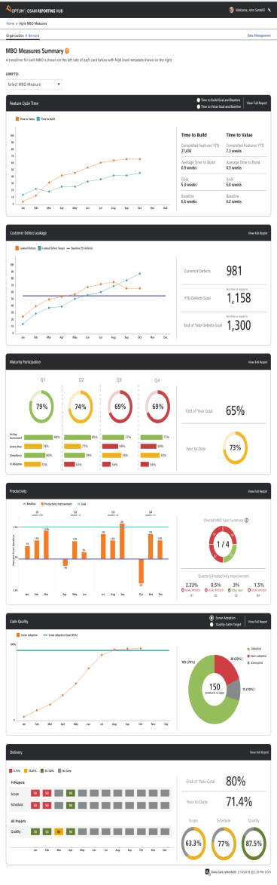


Summary Report – Maturity Participation MBO
Notes:
MVP – Org. filtering:
Default project assignment – majority of team is assigned to GL Dept.
Future:
Advance filter option – any of team is assigned to GL Dept.
Project may show in more than one filter option but never duplicated – (assignment goes to majority logic when rolled up.)
Projects can be set at inactive by GL Owner
Inactive applies to the organization hierarchy – unless another GL Owner activates (at which time the organization intersect will show the project)

Slide 29
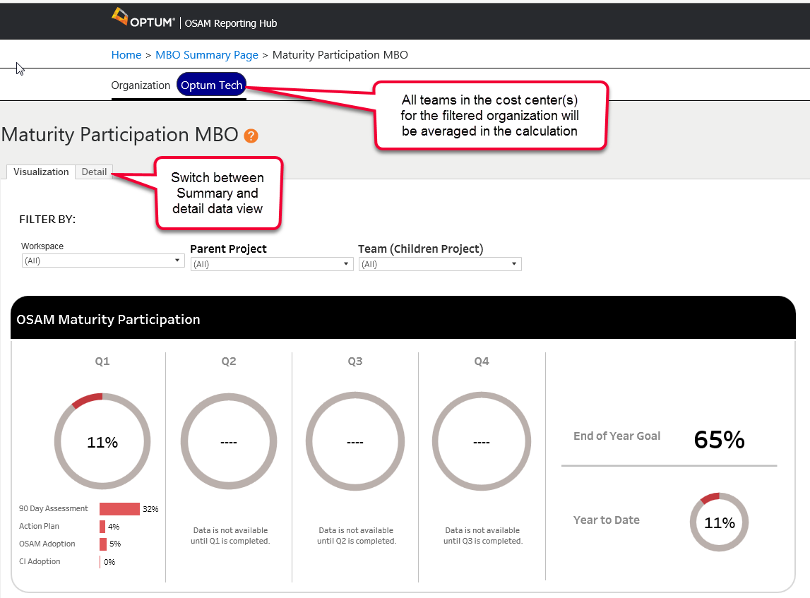
Summary Report – OSAM Maturity Participation MBO
Notes:
MVP – Org. filtering:
Default project assignment – majority of team is assigned to GL Dept.
Future:
Advance filter option – any of team is assigned to GL Dept.
Project may show in more than one filter option but never duplicated – (assignment goes to majority logic when rolled up.)
Projects can be set at inactive by GL Owner
Inactive applies to the organization hierarchy – unless another GL Owner activates (at which time the organization intersect will show the project)

Slide 30
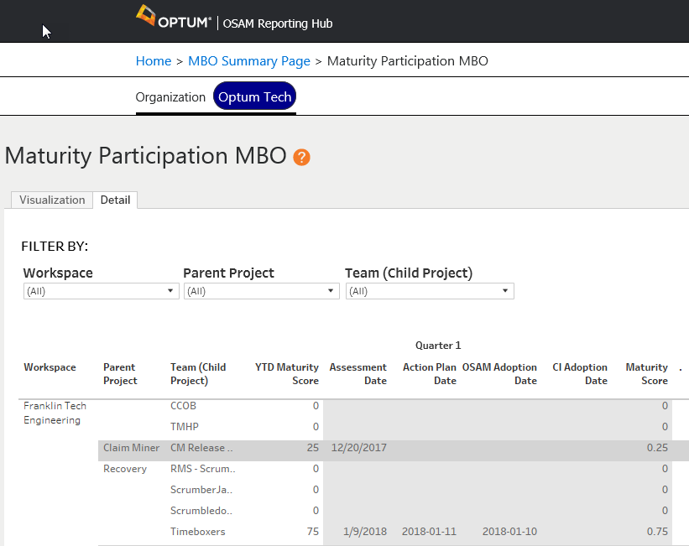
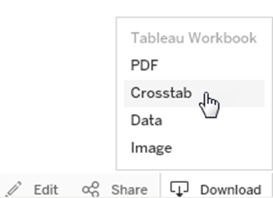
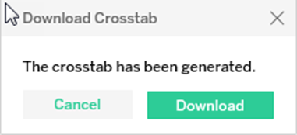
Detail Report – OSAM Maturity Participation MBO
Notes:
MVP – Org. filtering:
Default project assignment – majority of team is assigned to GL Dept.
Future:
Advance filter option – any of team is assigned to GL Dept.
Project may show in more than one filter option but never duplicated – (assignment goes to majority logic when rolled up.)
Projects can be set at inactive by GL Owner
Inactive applies to the organization hierarchy – unless another GL Owner activates (at which time the organization intersect will show the project)

Slide 31
Appendix
Job Aids:
OSAM Maturity Participation Report
Capability Assessment Job Aid
OSAM Planning Horizon
Notes:
Recommendations:
- Choose Continuous Improvement as Productivity MBO; keep Annual Improvement as a measure
Choose In-Year Improvement based on sustainability concerns, allow SUS Survey and SUS Audit
Benefits:
- Simplified setup and management (no baselining, stop 50% of DCR requests)

Slide 32
Productivity
Productivity(applies at product level)
What is changing?
Disconnect from PI time boxes to increase sample frequency and support all OSAM planning horizons
Rewire data intake to integrate product work and hours (vs. capital focused measure)
Minimize or eliminate baseline management, streamlining process and enabling teams to enroll any time
Productivity Continuous Improvement (new)
Measure: Ratio of quarterly productivity against previous quarter; 2.5% improvement per quarter
Target: Maximize number of quarters demonstrating 2.5%+ improvement (2 => Meets, 4 => Exceeds)
Productivity Annual Improvement (updated) (measure only)
Measure: Ratio of current annual productivity against previous year; 10% improvement per year
Target: Demonstrate 10% gains in overall productivity year over year

Slide 33
Productivity Data Element Detail
Group By
Cost Center Structure
Product, Asset or Billing Application (future enhancement)
Data Element | Attribute | Sub Attribute | Measure | Source System | Commonly Responsible
User Story | Plan Est. | Points | Productivity | CA Agile | Scrum Master or Team
User Story | Schedule State | Accepted | Productivity | CA Agile | Product Owner or Scrum Master
User Story | Accepted Date | N/A | Productivity | CA Agile | Derived from date state was set to accepted.
Mapped Project | Product or Application | Name | Productivity | OSAM Hub Data Management Admin | Cost Center Owner or Delegate
Actual Labor | Hours | N/A | Productivity | Planview or PPM Optics | Team Member
Project | Product or Application Billing Group | ID | Productivity | Planview or PPM Optics | PM or RTE

Slide 34
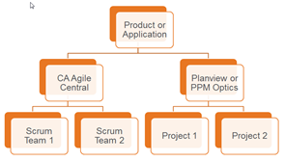
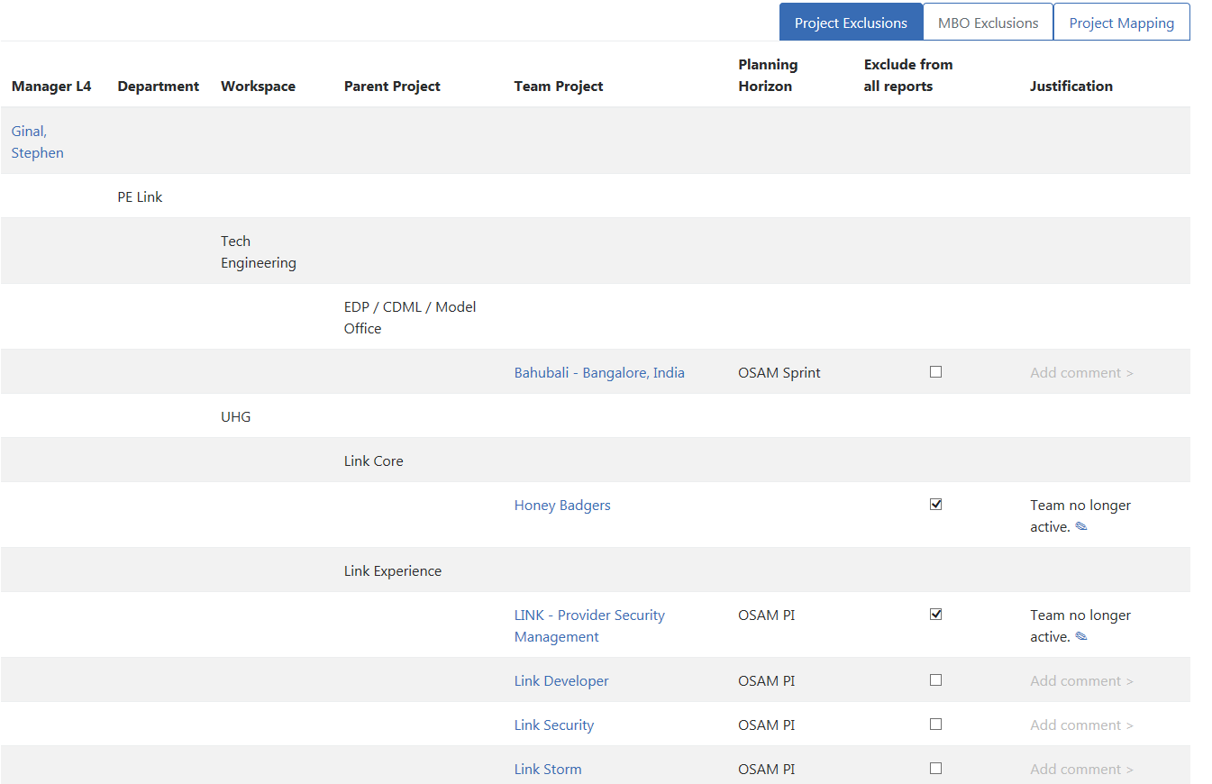
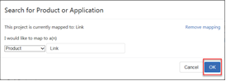
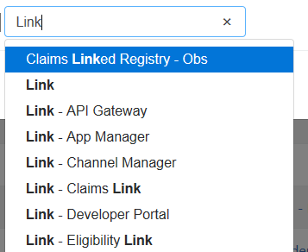
Pre Work & Actions to Take
CA Agile Central teams must be aligned to a product or application
Labor hours must be aligned to the same product or application
Notes:
Benefits:
- Simplified setup and management (no baselining, stop 50% of DCR requests)

Slide 35
Productivity Calculation Detail
Group By Cost Center Structure and Product, Asset or Billing Application (future enhancement)
Pre Condition All work and labor must be associated to a product or application billing group
Target/Goal 2.5% quarterly improvement
The productivity score is calculated independently for each quarter, and accumulates over the quarter. Therefore, the score for second and third month within the quarter are cumulative.
Baseline | All Product or Application Billing Group Velocity/Actual Labor for previous quarter
Current Quarter | All Product or Application Billing Group Velocity/Actual Labor for current quarter
Productivity | [Productivity Improvement for quarter] = ([Productivity Score till date for quarter] – [Productivity Baseline]) / [Productivity Baseline]

Slide 36
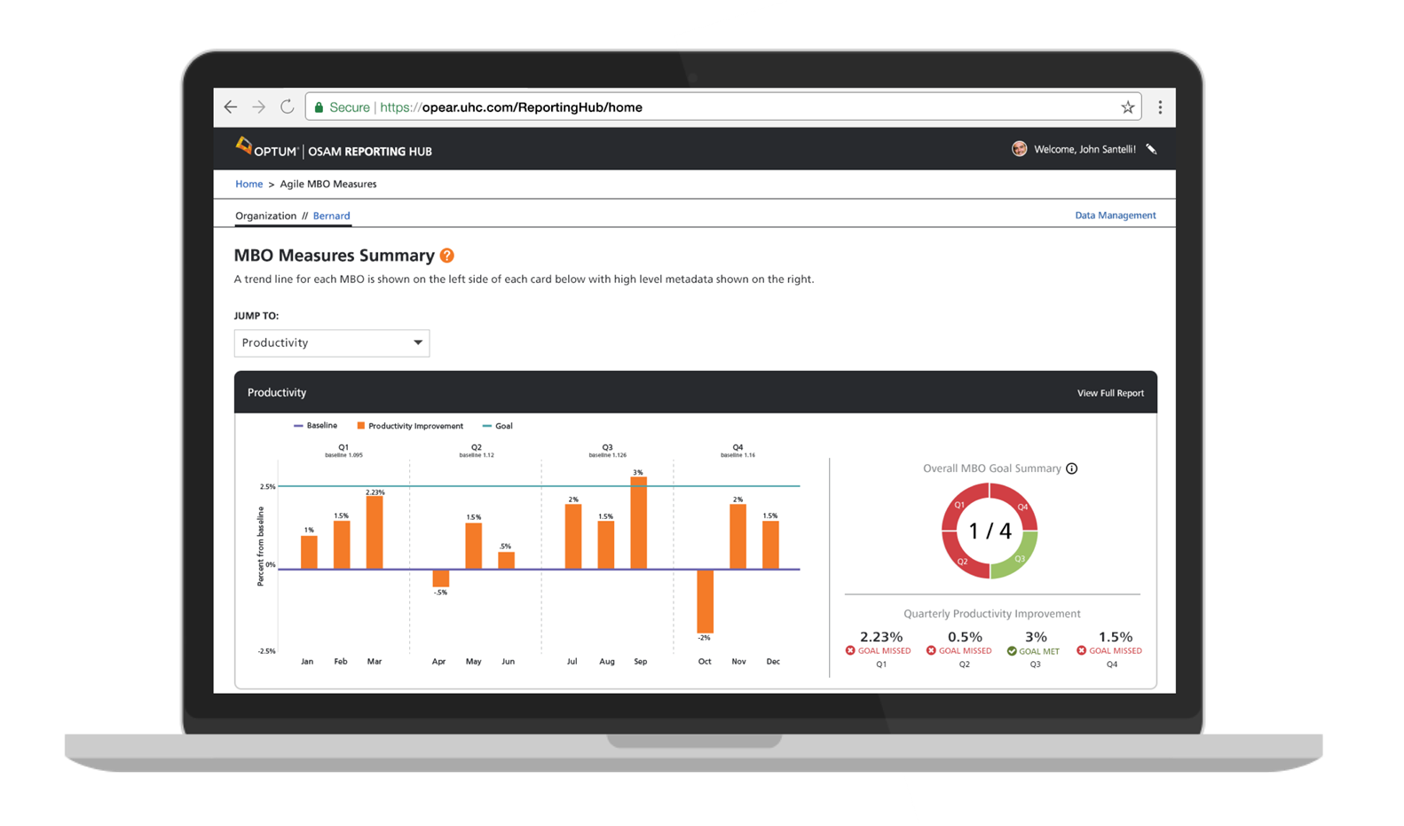
Summary Report – Productivity MBO
Notes:
This screen shows the productivity improvement for each quarter in the current MBO year. For quarters that have not yet begun, the data fields appear blank. For the current quarter and quarters that have already passed the MBO calculation is: [Productivity Improvement] = ([Productivity Score] – [Productivity Baseline]) / [Productivity Baseline]
For quarters which haven’t reached will display message as “Data is not available until <previous quarter> is completed” and populates data as it starts.
Metadata
To the right of the quarterly charts, the visualization displays the year-to-date performance against the productivity improvement goal.
Overall MBO Goal Summary The donut chart summarizes the pass/fail status of each quarter completed in the current year. The inside upper value shows the number of quarters that have met the goal over the total quarters completed YTD. And the bottom value represents productivity improvement percentage for entire MBO year. To meet the goal, the selected product should meet the quarterly goal twice in a year.
Quarterly Productivity Improvement The table provides additional detail for each completed quarter. The criterion to pass is the productivity improvement for the quarter should be greater than or equal to 2.5%.
NOTE: For quarters that have not yet begun, the data fields appear grey.

Slide 37
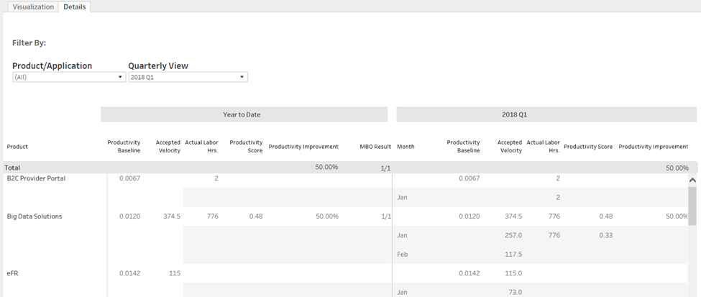
Summary Report – Productivity MBO
Notes:
The filter ‘Product/Application’ provides list of all products and application under selected leader. If you wish to select any one product, select the one you want from the list. The ‘Quarterly View’ filter provides completed and current quarters to select for. Once you select any quarter, the data on right side will change to selected quarter.

Slide 38
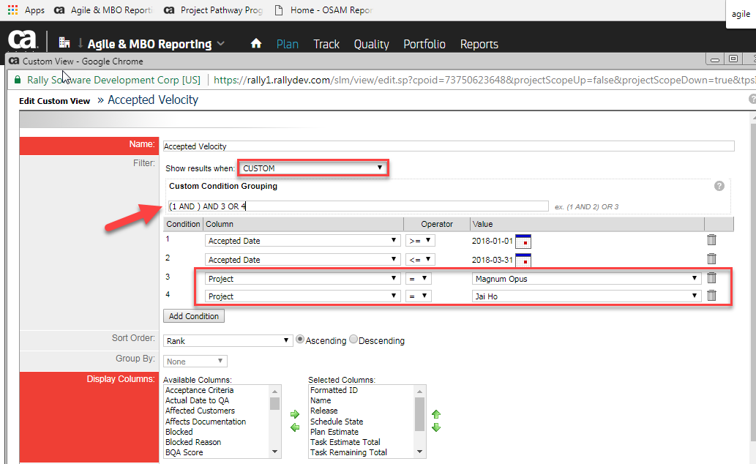
Trouble Shooting Tips / Job Aids Continued
Create a view to allow you to check all story points that have been accepted by accepted date
The accepted date for Q1 should be filtered to be from (01/01/2018 to 03/31/2018)
To derive the velocity for a product you have to include all the projects/teams that are mapped to that product in the Data Management tool
Notes:
Benefits:
- Simplified setup and management (no baselining, stop 50% of DCR requests)

Slide 39
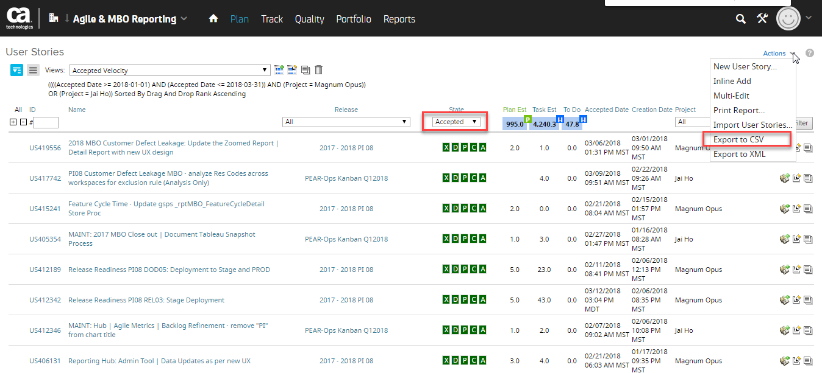
Trouble Shooting Tips / Job Aids Continued
Make sure the State is filtered to Accepted
Go to Actions and export to CSV
You can’t rely on the Plan Est points on this screen and you must export to calculate accurately
After exporting check the accepted date column and ensure the dates are with the range of the quarter you are trying to calculate.
Example, for Q1 2018 make sure accepted date if from 1/1/2018 to 3/31/2018.
Notes:
Benefits:
- Simplified setup and management (no baselining, stop 50% of DCR requests)

Slide 40
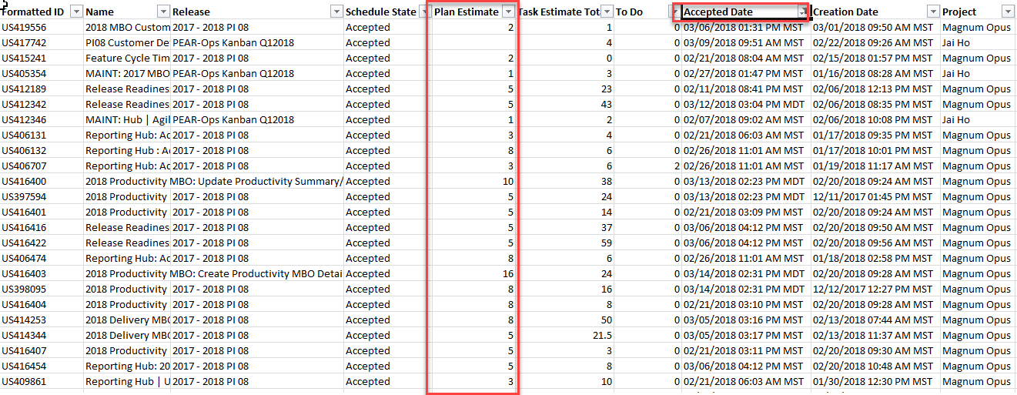
Trouble Shooting Tips / Job Aids Continued
Open the exported File
Ensure the accepted date is filtered to your requirement for the quarter
Then sum all Plan Estimate points
The Sum of all points accepted in the current quarter should equal the velocity on the Productivity report
*Note: The data in the OSAM Reporting Hub is updated daily. Therefore, if there were points accepted the of when you are trouble shooting those points will not be included till the following day.
Notes:
Benefits:
- Simplified setup and management (no baselining, stop 50% of DCR requests)

Slide 41
Appendix
OSAM Reporting Hub Data Management Training
How to prepare for productivity job aid
How to update Planview product attribute
How to update billing application attribute
Product analysis example
Adding a Planview Product
Adding an ASK Application Billing Group

Slide 42
Mature Agile Organization Structure
Mature Agile Org Structure(new)
Improvement Goal/Target
To Be Determined
Mature Agile Org Structure Calculation
(Dedicated Resources Percentage + Co-Located Resources Percentage) / 2
Dedicated Resources Percentage = Number of Dedicated Scrum or Agile “TEAM Members” / Number of Scrum or Agile “TEAM Members”
Co-Located Resources Percentage = Number of “Scrum or Agile TEAM Members” in same City / Number of “Scrum or Agile TEAM Members”.
Business Rules
Scrum or Agile team Member = TEAM Member with the Team Member Role of Scrum Master, Product Owner, or Development Team ( Development Team role can be assigned to any Developer including QA Developer)
Dedicated for a Scrum Master Role = 1-3 teams (if a Scrum Master is on 4 or more teams they are not considered dedicated)
Dedicated for Product Owner Role = 1-3 teams (if a Product Owner is on 4 or more teams they are not considered dedicated)
Dedicated for Development Team Role = 1 team ( if a Development Team Member is on 2 or more teams they are not considered dedicated)

Slide 43
Mature Agile Organization Structure Data Element Detail
Report can be viewed at
Workspace, Cost Center Owner, Parent Project, or child Project
Data Element | Attribute | Sub Attribute | Measure | Source System | Commonly Responsible
Users | Team Member | Yes/No | Mature Agile Organization | CA Agile | Scrum Master, Product Owner, RTE, or PM
Account Information | Role | Team Member Role | Mature Agile Organization | CA Agile | Each user should identify his/her role in CA Agile central (Scrum Master should verify)
Facility | Location | N/A | Mature Agile Organization | People Soft Data | Derived from People Soft Data on Employees

Slide 44
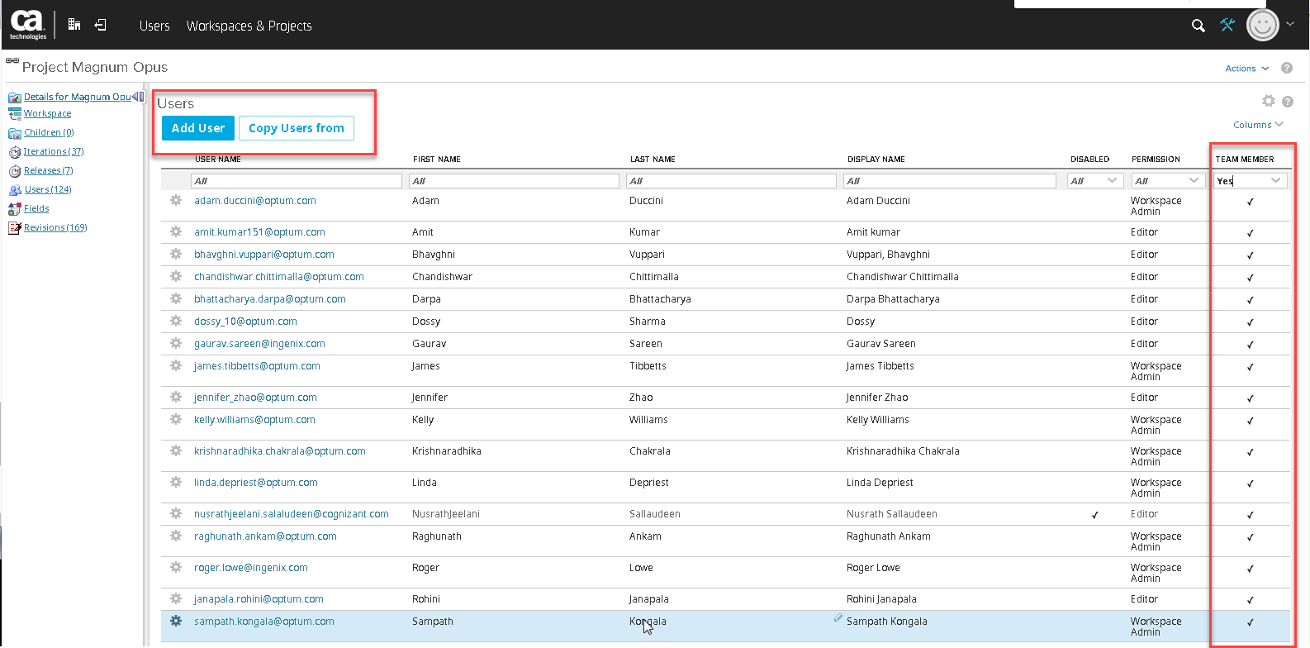
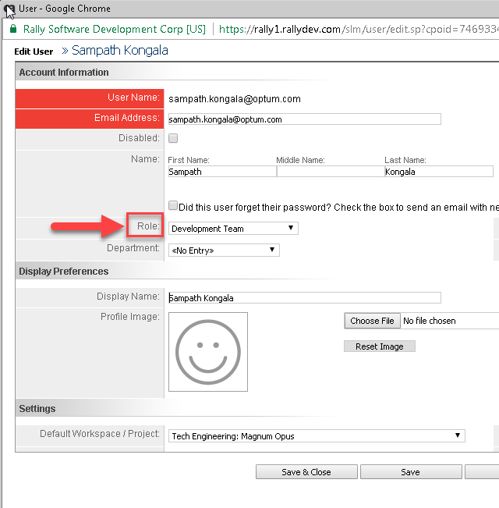
Pre Work & Actions to Take
CA Agile Central teams must update, correct, verify the team members assigned to the teams
CA Agile Central Scrum or Agile team members Must have their “Role” filled in
*note (Everyone using CA Agile Should have their role assigned scrum team members Must have their role assigned)

Slide 45
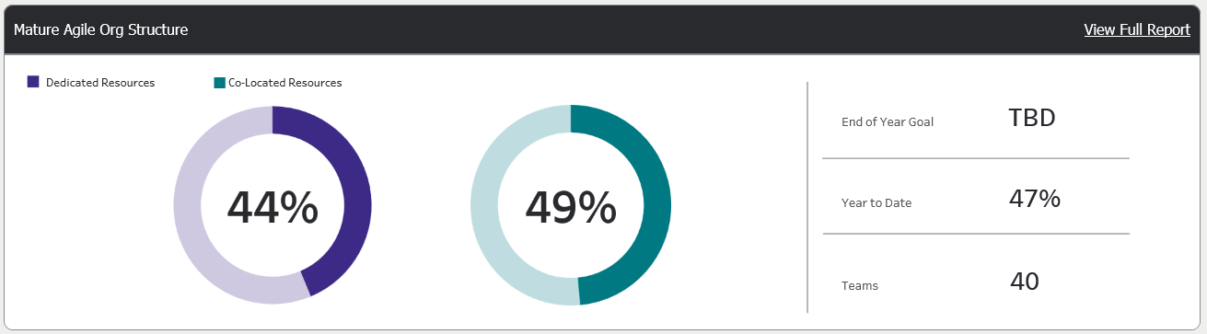
OSAM Reporting Hub – Report Visualization
Notes:
Here is an example. For this Product there are two CA Agile Central teams between the two 78% are Detected and 43% are co-located. (78% + 43%)/2= 61%

Slide 46
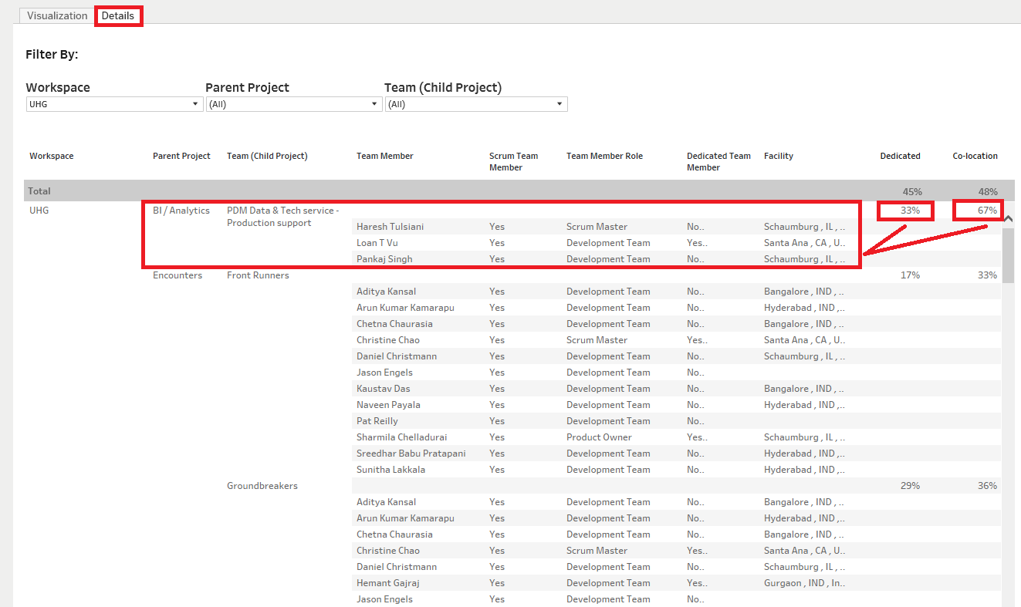
OSAM Reporting Hub – Report Visualization
Notes:
Of the 6 scrum team members 4 are dedicated 4/6 = 67%
Of the 6 scrum team Members the majority co-located are 2. Therefore, 2/6= 33%

Slide 47
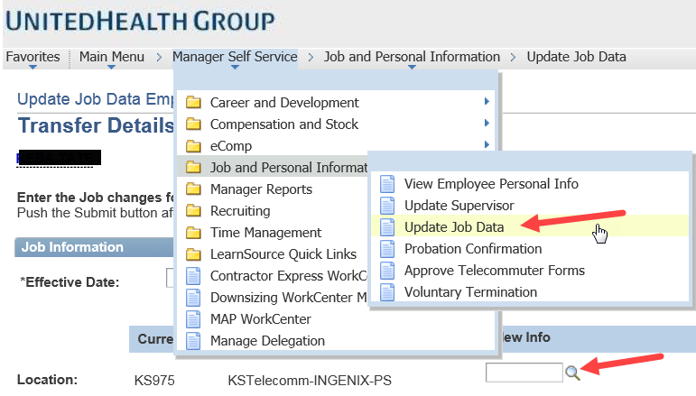
Trouble Shooting Tips
If the resource's Facility is incorrect From People Soft data their resource manager can update in Global Self Service.
Notes:
Any resource Manager can go update this information for a resource that reports to them

Slide 48
Appendix
Mature Agile Organization Structure MBO Job Aid

Slide 49
Delivery - Scope
Scope
What is changing?
The Scope delivery measure remains unchanged but will now be collected automatically from CA Agile rather than gathered through Tracker entries. Sprinting and Flow projects will be exempted from this measure.
Scope Delivery (updated)
Assessed by comparing the number of “Must” features completed at the end of the planning increment compared to the number planned at the beginning of the planning increment. Will also include features that do not have a MoScoW priority setting.
Planned = # of Must Features attached to Release object at PI Start + 7 days
Delivered = # of Must Features attached to Release object completed by Release object end date
Target: Number of delivered Must features must equal or exceed 90% of planned features.
Enabling this Measure
Feature Guidance
Features must be identified by MoSCoW priority scale. “Must” prioritized features make up the majority of planned content for a planning increment. If MoSCoW I used, only those features are counted as planned scope for this delivery measure.
Release Guidance
Features must be attached to the Program Increment (Release Object) within calendar 7 days of the release object start date to be counted as planned scope.

Slide 50
Delivery - Schedule
Schedule
What is changing?
The Schedule delivery measure remains unchanged but will now be collected automatically from CA Agile rather than gathered through Tracker entries. Sprinting and Flow projects will be exempted from this measure.
Schedule Delivery (updated)
Assessed by comparing the actual release end date to the committed release end date. If the actual date exceeds 10% beyond your original committed date, you fail.
Target: PI completion will be within a variance of 10% of PI duration from the planned end date in the CA Agile Release object.
Enabling this Measure
Release Guidance
The start and end dates in the Release time box object must be populated before execution on a planning increment starts and be maintained to reflect and time box beginning and end date changes made.
Time box end dates do not need to correlate to software releases (delivery of code for production use) – a timebox can contain one, many, or no releases to production.

Slide 51
Delivery - Quality
Quality
What is changing?
To allow for increasing release frequencies associated with Agile and Continuous Delivery, the old measure of “Sev 1 defects open at time box completion will be replaced with a cycle time measure focused on how quickly critical and major production defects are resolved.
Quality Delivery (updated)
Measure: Time from submission to closure will be calculated for all internal defects closed within the time box. Defects exceeding 28.0 days to closure are considered failing while defects less than or equal to 28.0 days to closure are considered passing.
Target: 100% of all critical and major defects are closed less than or equal to 28.0 days.
Enabling this Measure*
Defect Guidance
Quality Delivery is intended to be focused on internal defects. This includes Alpha, Beta, UAT, and other pre-production defects reported due to proactive quality work should be flagged as Beta/UAT Reported and not flagged as Customer Reported and will be included in the Delivery MBO

Slide 52
Delivery Data Element Detail
Group By
Cost Center Structure and Product or Billing Application
Data Element | Attribute | Sub Attribute | Measure | Source System | Commonly Responsible
CA Agile Central Project | OSAM Frame | Program Increment | Delivery – Scope & Schedule | CA Agile | RTE or SM
Release (PI Timebox) | Start Date | Date | Delivery – Scope & Schedule | CA Agile | RTE or SM
Release (PI Timebox) | Release Date | Date | Delivery – Scope & Schedule | CA Agile | RTE or SM
Mapped Project | Product or Application | Name | Delivery - All | OSAM Hub Data Management Admin Tool | Cost Center Owner or Delegate

Slide 53
Delivery Data Element Detail – Cont.
Group By
Cost Center Structure and Product or Billing Application
Data Element | Attribute | Sub Attribute | Measure | Source System | Commonly Responsible
Feature | Release | Release Name | Delivery – Scope | CA Agile | RTE or SM
Feature | MoSCoW | Must and Null | Delivery – Scope | CA Agile | RTE or SM
Defect | Creation Date | Date | Delivery – Quality | CA Agile | Delivery Team, Support, PO
System | Current Date | Age | Delivery – Quality | Quality | N/A derived calculation
Defect | Severity | Crash, Critical, Major | Delivery - Quality | Quality | Delivery Team, Support, PO
Defect | Resolution | Not a Defect, Rejected, Duplicate Issue | Delivery - Quality | Quality | SM, Delivery Team, PO

Slide 54
Delivery Calculation Summary
Group By Cost Center Structure and Product, Asset or Billing Application
Pre Condition All work must be associated to a product or application billing group
Target/Goal 90% of all products/applications meet delivery goal
* Planned feature count = total features assigned 7 days after PI start date. Delivered feature count = total features assigned to PI on PI release/end date
** Schedule calculations are based on original PI Start and Release date
*** All failures captured in the month defect ages
Scope | Number of delivered features is at least 90% of planned for each product or application Program Increment*
Schedule | Actual Program Increment schedule days does not exceed 110% of original Program Increment schedule days**
Quality | All critical and major defects closed within 28 days ***

Slide 55
Delivery Calculation Detail - Scope
Group By Cost Center Structure and Product, Asset or Billing Application
Pre Condition All work must be associated to a product or application billing group
Scope Target/Goal 90% of all committed features are delivered in the Program Increment
Single PI for a Product/Application Calculation | Find all PI Planning Horizon teams for product selected in filter of report Gather all Program Increment (release) time boxes Save a snapshot/baseline of PI dates and associated feature count Snapshots/baselines are captured at creation, 7 days after start and the end On PI end date compare associated feature count to baseline If number of features delivered is at least 90% of committed pass
Multiple PI Calculation | Each individual PI scope score is averaged and displayed as a percent for the given month for the selected Product/Application
Organization Level Calculation | Each PI for all Products/Applications mapped for the leader selected will be averaged and displayed as a percent for the given month.
Year to Date Calculation | All products selected in the filter are calculated by month and will be averaged for the year to date measure.

Slide 56
Delivery Calculation Detail - Schedule
Group By Cost Center Structure and Product, Asset or Billing Application
Pre Condition All work must be associated to a product or application billing group
Schedule Target/Goal Committed schedule does not extend more than 10%
Single PI for a Product/Application Calculation | Find all PI Planning Horizon teams for product selected in filter of report Gather all Program Increment (release) time boxes Save a snapshot/baseline of PI dates and associated feature count Snapshots/baselines are captured at creation, 7 days after start and the end On PI end date compare the actual end date to the original PI end date If PI end date is within 10% of the original pass
Multiple PI Calculation | Each individual PI schedule score is averaged and displayed as a percent for the given month for the selected Product/Application
Organization Level Calculation | Each PI for all Products/Applications mapped for the leader selected will be averaged and displayed as a percent for the given month.
Year to Date Calculation | All products selected in the filter are calculated by month and will be averaged for the year to date measure.

Slide 57
Delivery Calculation Detail - Quality
Group By Cost Center Structure and Product, Asset or Billing Application
Pre Condition All work must be associated to a product or application billing group
Delivery Target/Goal 90% of all products/applications meet delivery goal
Individual Product Calculation | Find all teams for product selected in filter of report Gather all open critical and major severity defects Calculate the number of days each defect has been open If any are greater than 28 days set current month quality score to zero
Multiple Product Calculation | Each individual product quality score is averaged and displayed as a percent for the given month
Organization Level Calculation | Each product mapped for the leader selected will be averaged and displayed as a percent for the given month.
Year to Date Calculation | All products selected in the filter are calculated by month and will be averaged for the year to date measure.

Slide 58
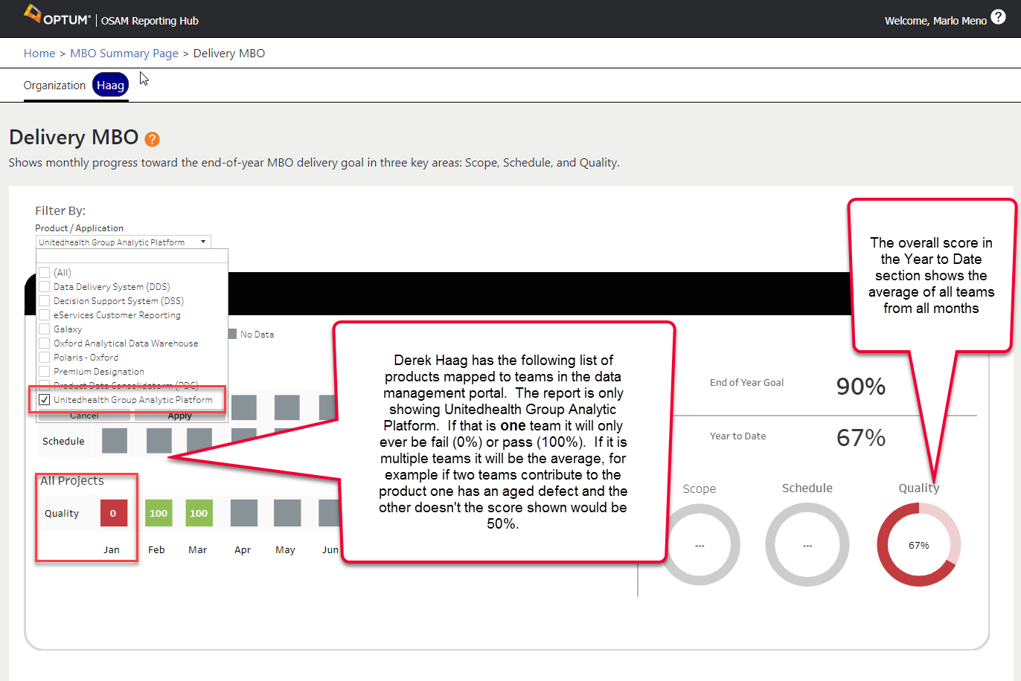
Delivery Summary Report – Quality

Slide 59
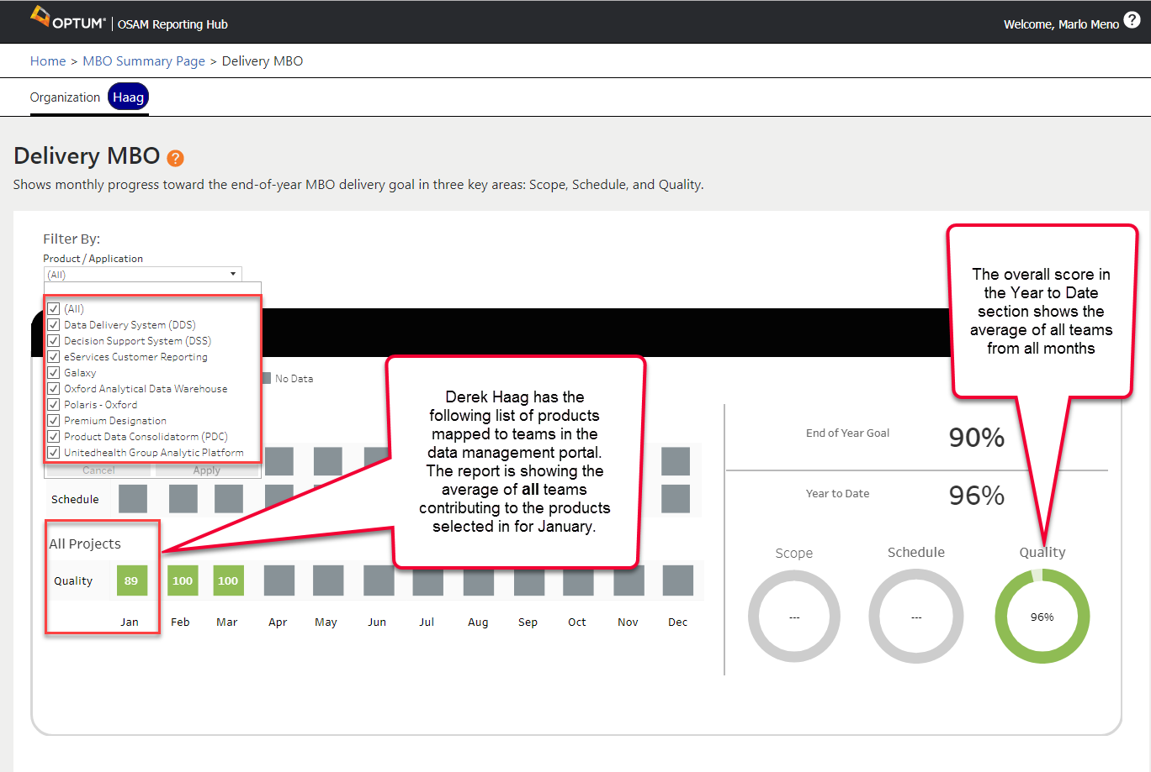
Delivery Summary Report - Quality

Slide 60
Appendix
OSAM Reporting Hub Data Management Training
Delivery MBO Job Aid
Delivery MBO Snap/Baseline logic detail

Slide 61
Code Quality Overview
Code Quality
What is changing?
New measure to drive code quality adoption
For Code Quality Adopted Teams (updated)
Measure: Team improvement towards individualized code quality gate targets
Target: Achievement of selected quality goal and/or implementation of automated release pipeline enforcement of code quality controls
Meeting target gate = Meets, beating gate by 2 = Exceeds
Implementing automated release pipeline enforcement = Exceeds (regardless of gate progress)
For Code Quality Adopting Teams
Measure: Adoption of code quality analysis (SonarQube)
Target: 95% Org-level adoption targets for groups with no/limited Sonar implementation
<90% = NI-1 | 90%-<95% = NI-2 | 95%-<97% = ME-3 | 97%-<100 = ME-4 | 100% = EE-5
Notes:
What is the CI Integration indicator?
How do we know the groups that have sonar limitations?
What is the target list??? It does not match what was built.

Slide 62
Code Quality Configuration and Mapping with SonarQube
Ca Agile Central
Application Billing Group
PPMOptics Project Labor Hours
Planview Product
OSAM Reporting Hub Data Management
MBO Exemption and Quality Target Management
Employee ID
Planview Project Labor Hours
Ask Application Global ID’s
SonarQube Code Quality
SonarQube Code Quality
Department ID
Facility/Location
Finance
Team Members
Cost Center/Department ID
L3-L1 Leadership
Work Items

Slide 63
Code Quality Configuration and Mapping with SonarQube
What data is the source of truth for the Code Quality Adoption MBO?
OSAM Reporting Hub – Data Management Portal
Product and Application
All products and applications found to be actively being worked on by a team are in scope for Code Quality Adoption
SonarQube
Product and Application
All products and applications found and matched to OSAM Reporting Hub Data Management products and applications are considered adopted
What data drives alignment of the MBO and SonarQube?
ASK Global ID
Planview Product ID (PE only)
Details – Code Quality Adoption Rule:
Check the SonarQube data to see if there is a Planview Product ID in the Custom Metric field. If there is, validate the ID is associated with a valid Planview Product. If it is a valid product check current gate. If gate is not equal to RedZone, indicate the product has adopted code quality.
If it is not a valid product ID, check if ASKID is in the Sonar Project field. If ASK ID is not found either the product or application configured in SonarQube is not valid or configuration in the OSAM Reporting Hub Data Management portal has not been done.
If ASK ID is populated, find the associated Billing Application ID if valid Billing Application ID is found check current gate. If gate is not equal to RedZone, indicate the product has adopted code quality. and indicate the application has adopted code quality.
If a billing application is not found, either the application configured in SonarQube is not valid or configuration in the OSAM Reporting Hub Data Management portal has not been done.

Slide 64
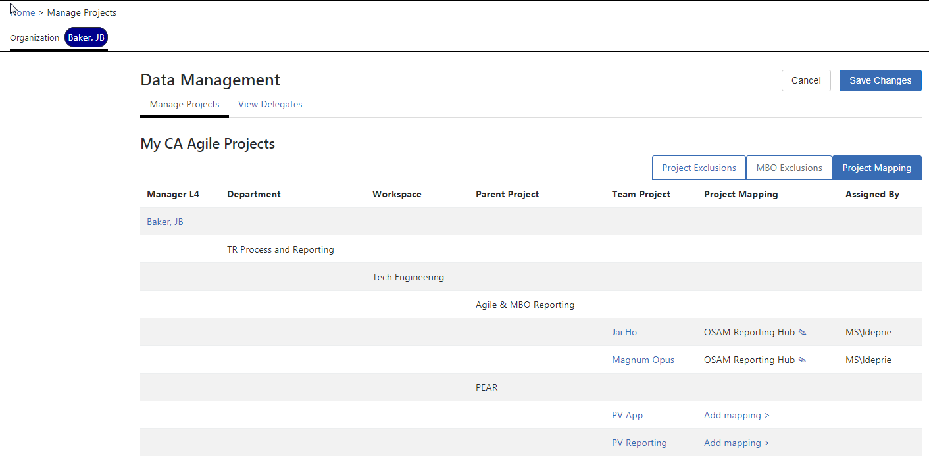
Code Quality Configuration and Mapping with SonarQube
In the example below, JB Baker has one product that his teams are working on. The OSAM Reporting Hub is the current product and the unmapped teams below were aligned to a product that has been sunset. In this situation the Code Quality Adoption goal is to have one of one products in SonarQube.

Slide 65
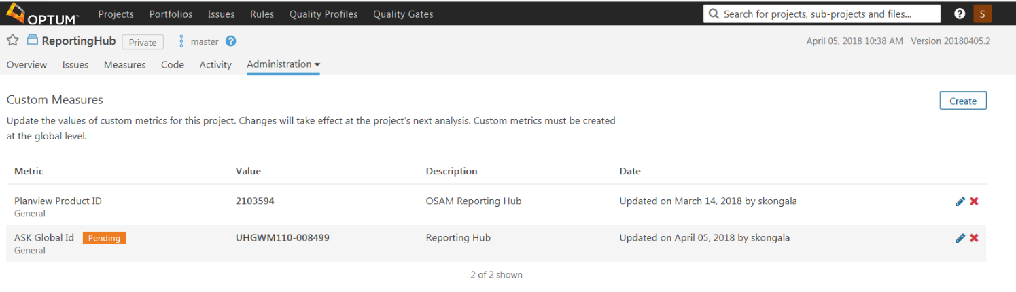
Code Quality Configuration and Mapping with SonarQube
The OSAM Reporting Hub team has implemented SonarQube and have set up the custom measure to provide the mapping for the MBO.

Slide 66
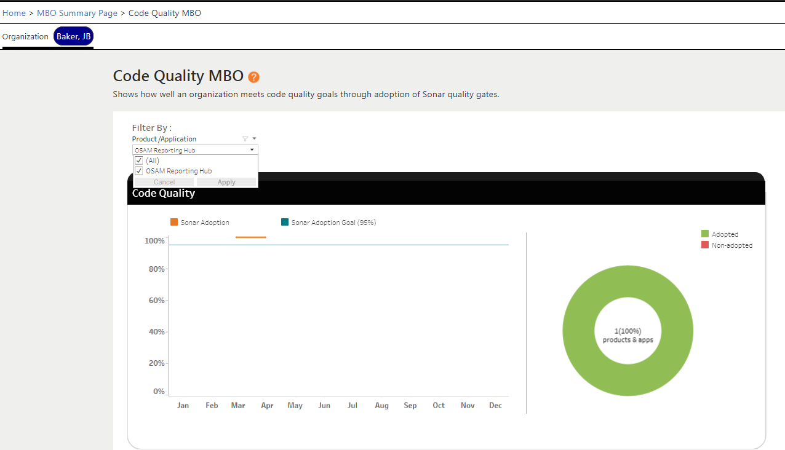
Code Quality Hub Reporting: Sonar Adoption
The Code Quality MBO report shows that for JB Baker, he has one product in scope for adoption and that one product has been set up in SonarQube which tells us Code Quality has been adopted.

Slide 67
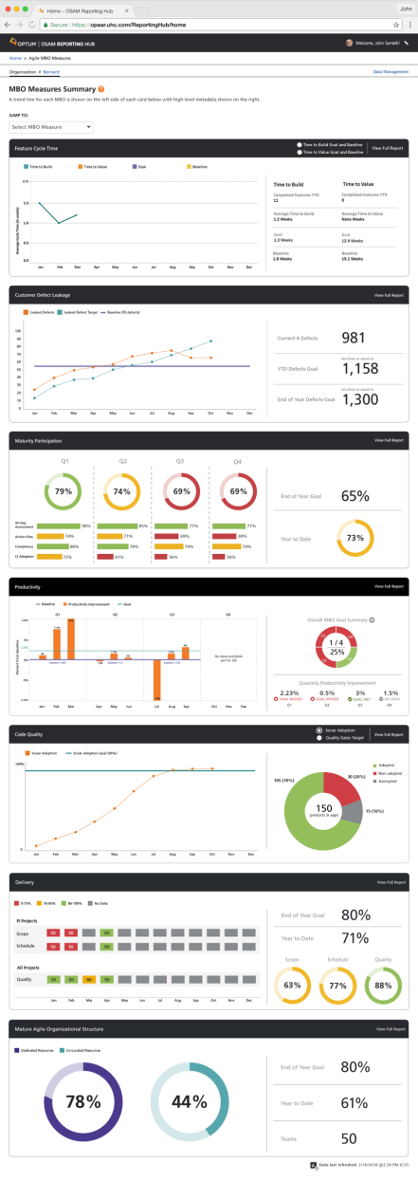
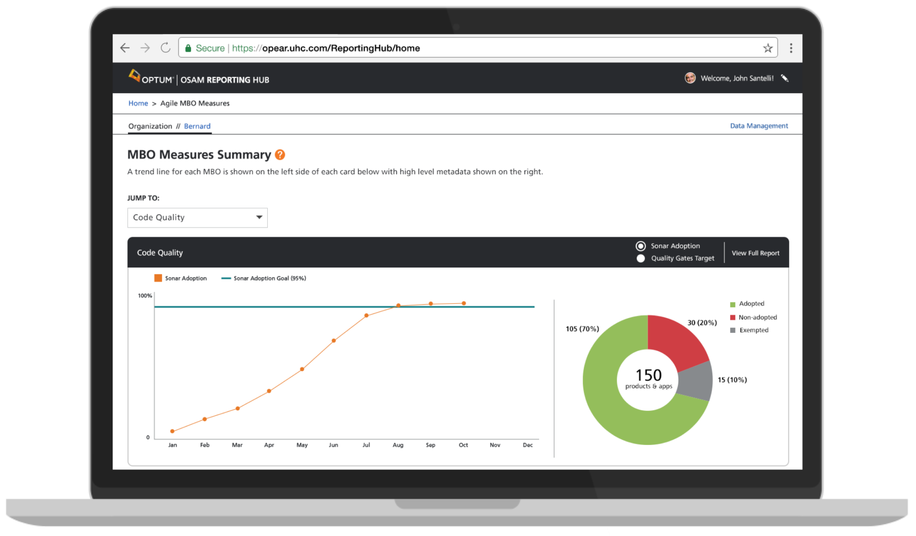
Code Quality Hub Reporting: Sonar Adoption

Slide 68
Code Quality Configuration and Mapping with SonarQube
Actions to take?
Identify your OSAM Reporting Hub Delegate(s) and the product or application delivery leader(s) and schedule a meeting to make sure both pieces of the configurations are complete.
The How to Configure Code Quality Adoption MBO Report Job Aid can be used to walk through each step of the configuration.

Slide 69
Appendix
Coming Soon -
Code Quality Targets
Set up and target submission guidance
Code Quality Target MBO report trainings

Slide 70
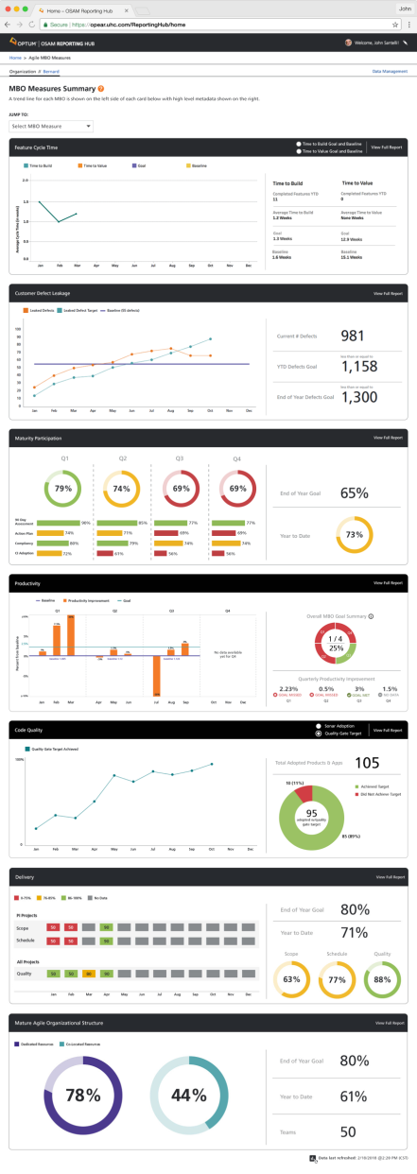
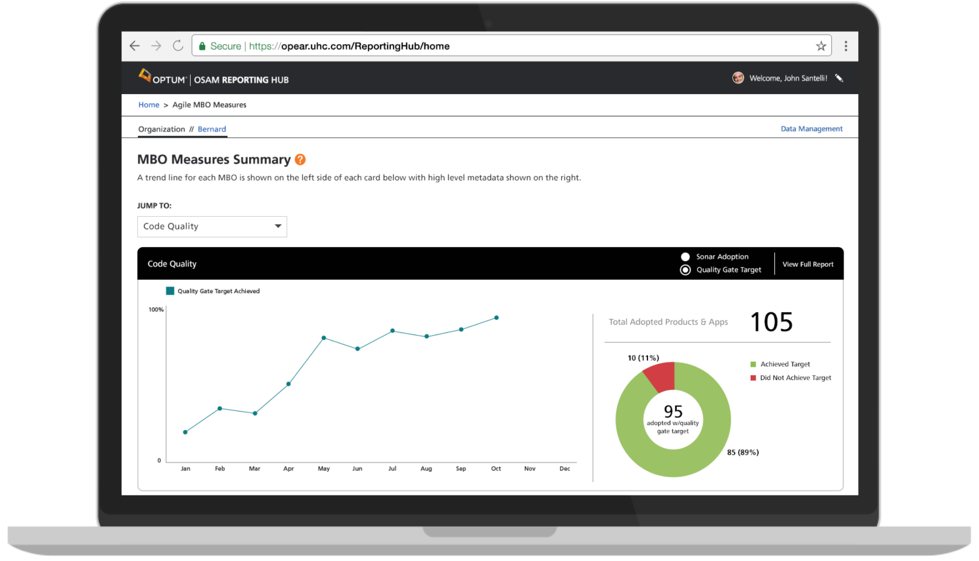
Code Quality Hub Reporting: Quality Gate Target

Slide 71
Code Quality Terminology and Operational Constructs
Rules
Logic designed to identify existence of a problematic coding practice
Categorized by type (bug, vulnerability, maintenance issue) and severity
Typically sourced externally but custom rules may be written
Quality Profiles
A collection of rules for a specific language, bundled together to define the coding practice requirements to be enforced by Sonar
Assigned at the code project level; multiple profiles may be created
Defined and curated by Optum
Quality Gates
Collections of simple thresholds, each of which must pass in order to pass the Quality Gate
Applied at the code project level; the status of a collection of projects (e.g. a product/application) will be displayed as the lowest gate of its member projects
Defined and curated by Optum
Severities
Categorizations of impact for a finding (bug, vulnerability, or code smell), categorized into Blocker, Critical, Major, Minor, and Info
Defined with the definition of a rule
Sourced with rules but may be customized and curated by Optum
“New” Code
Differentiating concept allowing teams can hold new code to a higher standards than while “catching up” on quality for code written previously at a managed pace
Defined currently as lines of code added or changed on or since Jan 1, 2018
Date threshold set by Optum

Slide 72
Code Quality Understanding Code Quality Goals
Progressive gates act as a funnel, advancing quality criteria for new builds
to match the level of quality already achieved by the team
 | Static Analysis Issues |  |  |  |  | Code Coverage |  | Unit Tests
Quality Gate | New Blocker | New Critical | Overall Blocker | Overall Critical | Overall Major | Overall Coverage | New Coverage | # Failures
EXEMPT |  |  |  |  |  |  |  | 0
ADOPTION | 0 | 0 |  |  |  |  |  | 0
Gate 00 | 0 | 0 |  |  |  |  | 60 | 0
Gate 01 | 0 | 0 |  |  |  | 10 | 60 | 0
Gate 02 | 0 | 0 |  |  |  | 20 | 60 | 0
Gate 03 | 0 | 0 | 0 |  |  | 30 | 60 | 0
Gate 04 | 0 | 0 | 0 |  |  | 40 | 60 | 0
Gate 05 | 0 | 0 | 0 |  |  | 50 | 60 | 0
Gate 06 | 0 | 0 | 0 | 0 |  | 60 | 70 | 0
Gate 07 | 0 | 0 | 0 | 0 |  | 70 | 70 | 0
Gate 08 | 0 | 0 | 0 | 0 |  | 80 | 70 | 0
Gate 09 | 0 | 0 | 0 | 0 | 0 | 90 | 70 | 0
RED ZONE
Adopting teams
Quality Gate Target teams

Slide 73
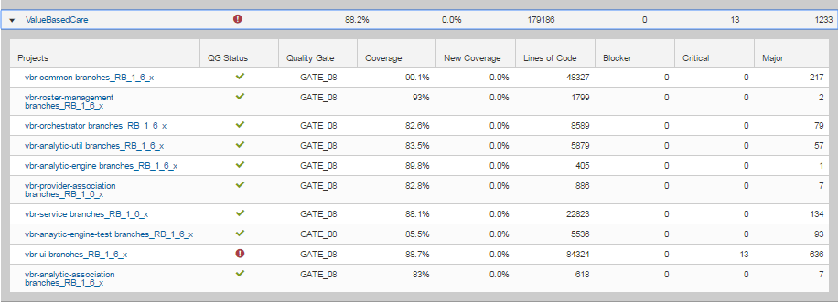
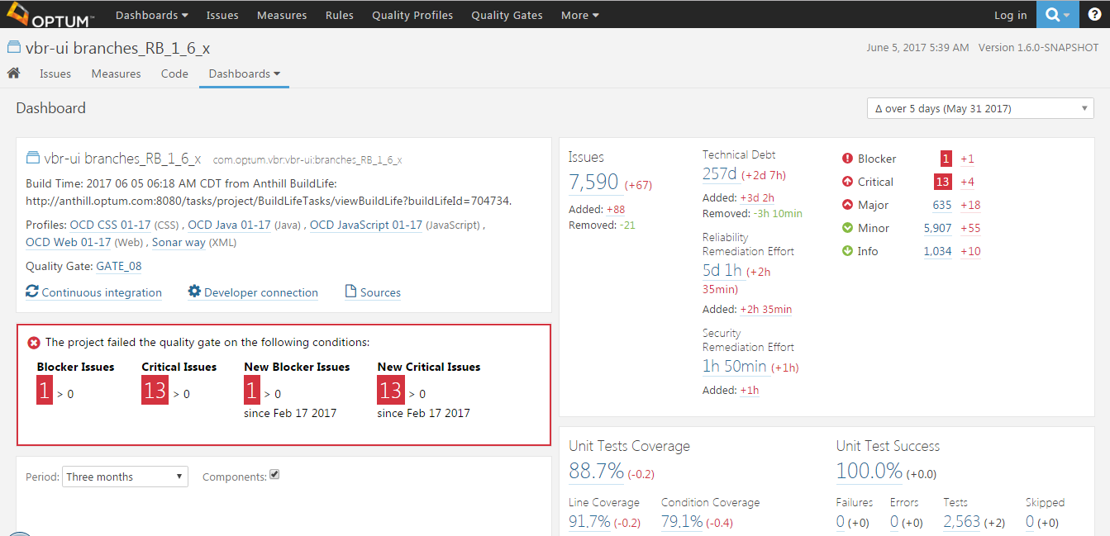
Code Quality Troubleshooting Tips
Dashboard views help teams identify problem spots
Project views provide notifications, metrics, and drill-downs to pinpoint and address the problems

Slide 74
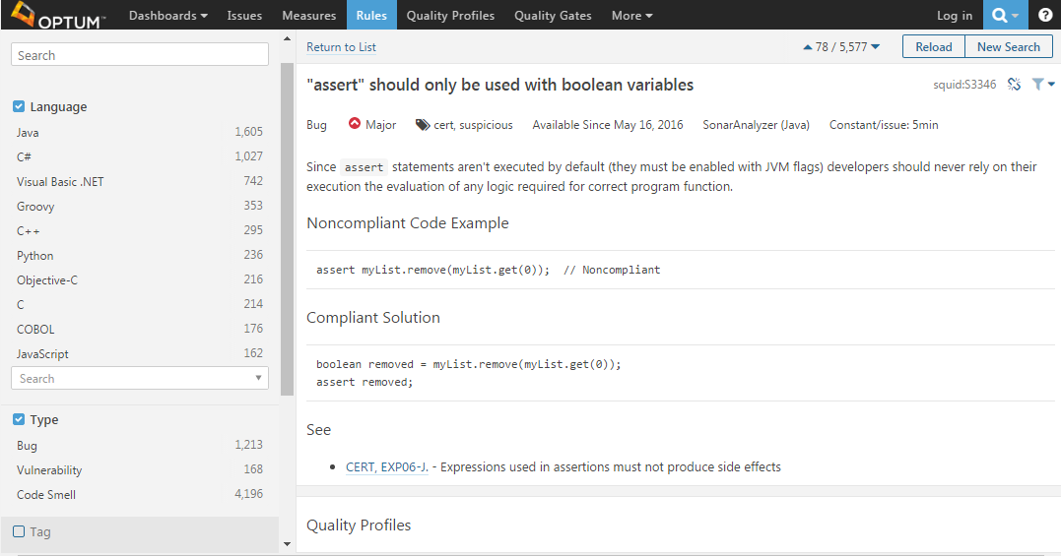
Code Quality Troubleshooting Tips
Rule Definition Contents
Explanation of impact
Examples of non-compliant and compliant patterns
Link to rule origins (sourced rules)
Optum’s classification of severity
Estimation of time to fix per instance

Slide 75
Customer Defect Leakage Overview
Customer Defect Leakage (applies at product level)
What is changing?
Take advantage of new data linkages to allow reporting by product as well as org structure
Measure and calculations (unchanged)
Measure: Annual improvement in defect leakage trend, displayed as YoY monthly cumulative performance
Target: 10% improvement versus prior year
Scope
Optum Technology
Workspaces currently Included
Optum
Tech Engineering
TFS Enterprise
Purpose
Drive quality focus by reducing leaked defects.
This will allow us to bring the customer closer by helping to improve our NPS score and will result in increased customer loyalty.

Slide 76
Customer Defect Leakage Calculations detail
Group By
Cost Center Structure
Product, Asset or Billing Application (future enhancement)
Target/Goal
10% improvement from 2017
Customer Defect Leakage | Baseline | The Number of Customer Reported Defects in 2017 where The Reported by field is set to reported by customer The Resolution field is not set to any of the following Not a defect Duplicate issue Rejected
 | Current Year | The number of Customer reported defects from year to date starting on 1/1/2018 with the same criteria as above
 | Target | (Baseline * .90)=2018 Goal

Slide 77
Customer Defect Leakage Data Element Detail
Group By
Cost Center Structure
Product, Asset or Billing Application (future enhancement)
Target/Goal
10% improvement from 2017
Measure | Source System | Data Element | Attribute | Sub Attribute | Commonly Responsible
Customer Defect Leakage | CA Agile | Defect | Reported by | Customer Reported (Included) | Customer Support, PO, or Designated team member
Customer Defect Leakage | CA Agile | Defect | Creation Date | N/A | Derived
Customer Defect Leakage | CA Agile | Defect | Resolution | Not A Defect Duplicate Issue Rejected (Excluded) | Scrum Master/Delivery Team/PO

Slide 78
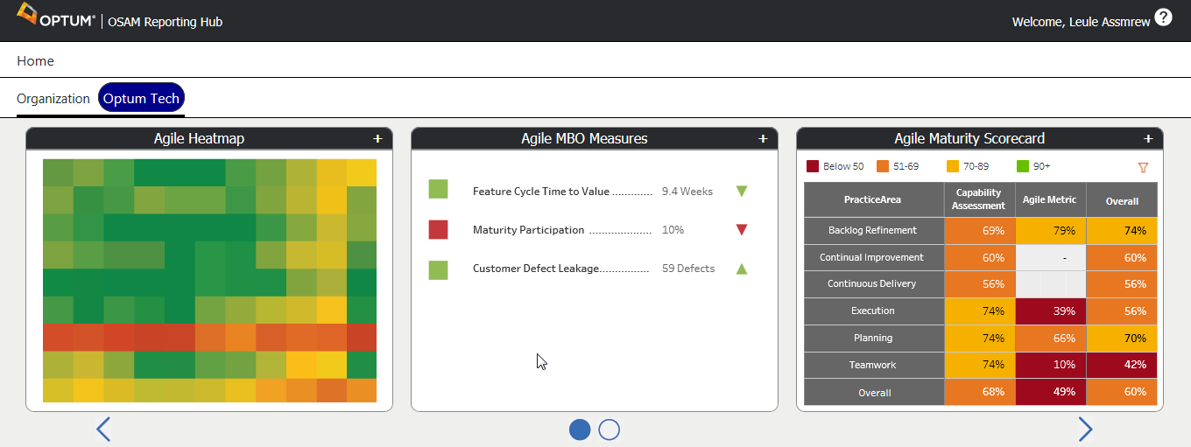
OSAM Reporting Hub – Report Visualization

Slide 79
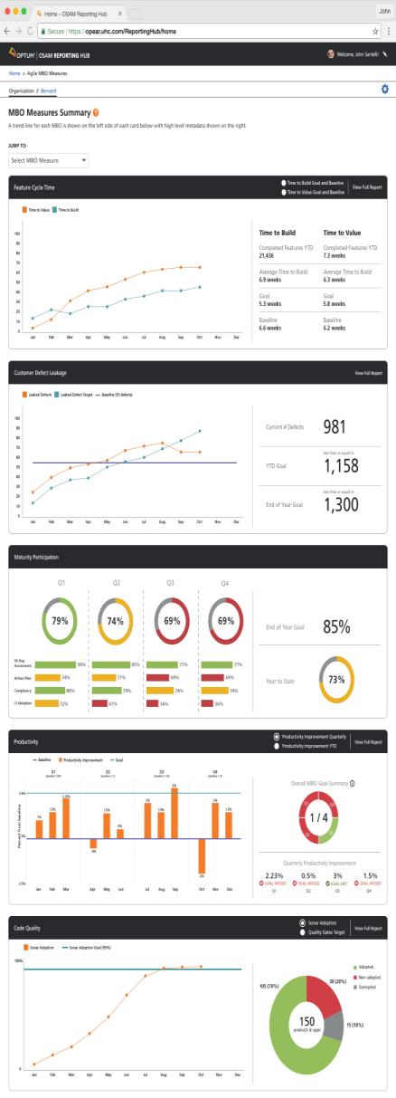
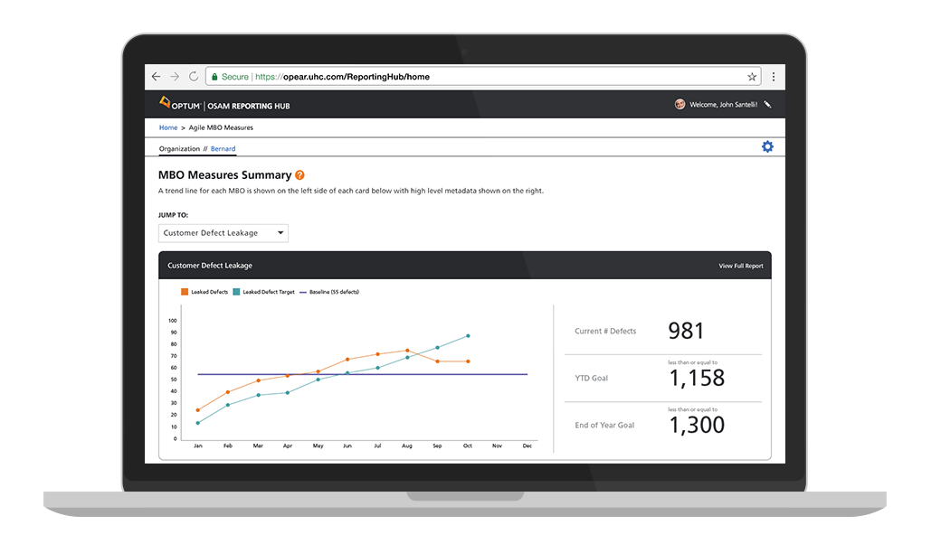
OSAM Reporting Hub – Report Visualization
Summary Report – Customer Defect Leakage MBO

Slide 80
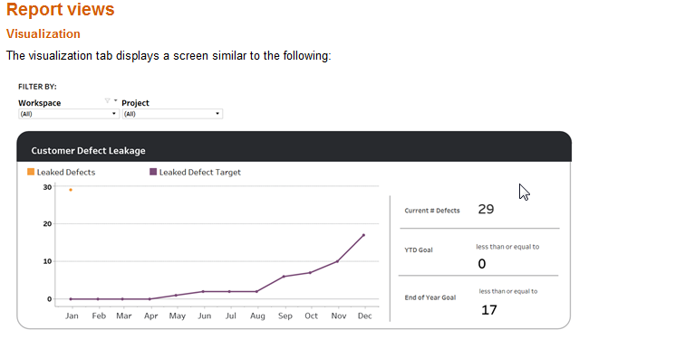
Customer Defect Leakage Report Visualization
Notes:
You can click on the “View Full Report” in the upper right corner of the summary card to drill down to a specific Agile Central Project/team and access the detailed data.
You Can Filter by Workspace and/or by Project
Supporting Data elements
On the left side, the visualization shows a trend chart with the Leaked defects logged at each month during the current MBO year.
Leaked Defects (Orange line): The number of leaked defects logged at each month during the current MBO year.
Leaked Defect Goal (Purple Line): A line showing the maximum number of leaked defects a team can have and still remain within the MBO level. In other words, if the orange line remains at or below the purple line, it meets the company objective for improvement in this area. If the orange line goes above the purple line, it does not meet the objective.
On the right side, the current number of defects, year to date goal, and end of the year goal is calculated and represented

Slide 81
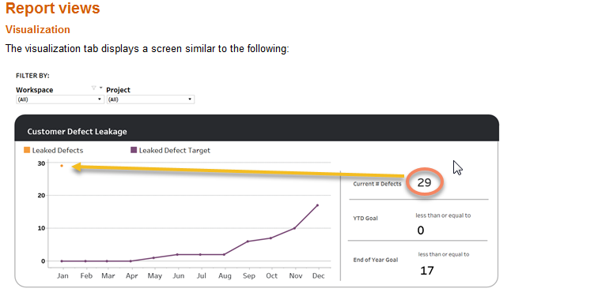
Customer Defect Leakage Reading the Report Visualization
Notes:
The current number of defects = the total number of customer reported defects logged from the start of 2018 (1/01/2018) to when the report was last updated (jobs run daily).

Slide 82
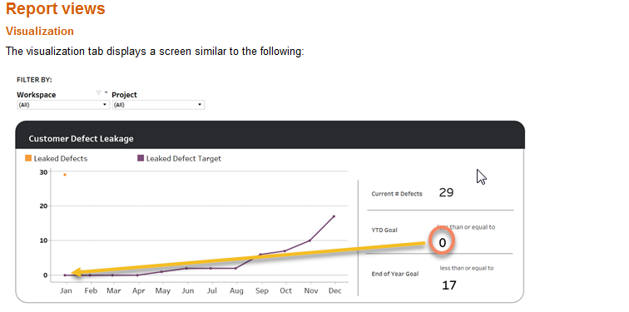
Customer Defect Leakage Reading the Report Visualization-Continue’d
Notes:
The Year to Date Goal = the number of customer reported defects logged during the current month same time last years with a reduction of 10%.

Slide 83
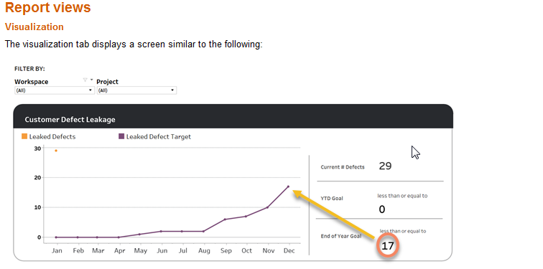
Customer Defect Leakage Reading the Report Visualization
Notes:
End of the year goal = the number of customer reported defects logged last year with a reduction of 10%.

Slide 84



Customer Defect Leakage Trouble Shooting Tips
Create a custom view in CA Agile Central with the following criteria.
Selected Column
Formatted ID, Name, Defect Reported By, Creation Date, Project, Resolution
Conditions
(Creation Date >= 2018-01-01) AND
(Reported By = Customer Reported) AND
(Resolution != Not a Defect) AND (Resolution != Duplicate Issue) AND (Resolution != Rejected)
Notes:
Creating this view will allow you to see how many Customer reported defects a team has since the beginning of 2018

Slide 85


Customer Defect Leakage Trouble Shooting Tips - Example
When the custom view is applied to a leaf child project it should match the data in on the Customer Defect Leakage report on the OSAM Reporting Hub
Notes:
You can compare what the OSAM Reporting Hub shows for your project/team with what is actually in CA Agile Central to Ensure accuracy.

Slide 86
Appendix
Job Aids
Customer Defect Leakage MBO Job Aid
How to create A customer reported defect Job Aid

